Slide 1
Cedar & Vine
Business Plan and Funding Request
A 46-seat neighbourhood bistro in West Asheville serving a short, seasonal dinner menu six nights a week, with a weekend brunch service.
SBA 7(A) / MICROLOAN
PREPARED FOR BANK UNDERWRITER UNDER SBA SOP

Slide 2
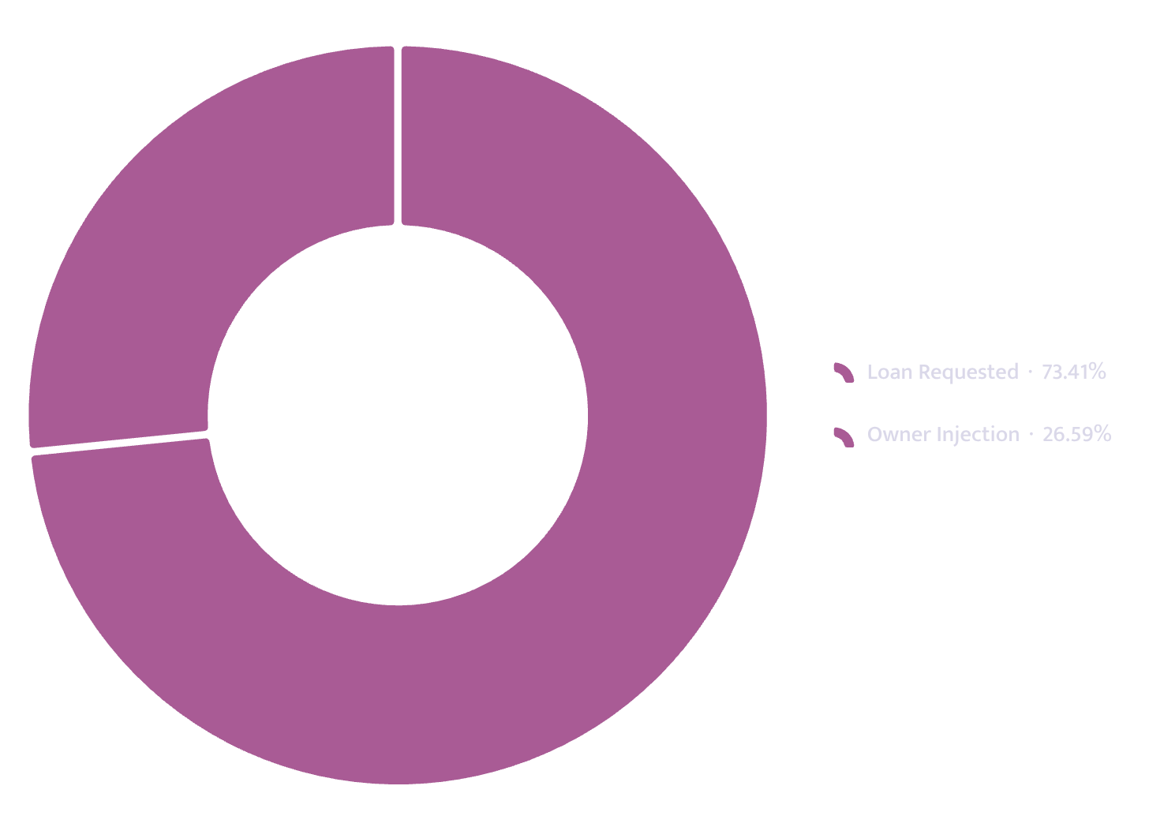
The Funding Request
$265,000
SBA 7(a) loan over 120 months at 10.75%, against an owner injection of $96,000 — 27.4% of total project cost of $350,200.
Loan Requested
Owner Injection
$265,000 — 75.7% of total project cost
$96,000 — 27.4% of total project cost
Monthly Debt Service
Year-1 DSCR
1.47 against a 1.25 lender floor
$3,613 over 120 months

Slide 3
At a Glance
The Plan in Six Numbers
$870K
1,896
Year-1 Revenue
Break-Even Units/Month
Mo. 5
55%
Break-Even Reached
Capacity at Break-Even
$9,980
$25.90
Cash Low Point (Month 4)
Contribution Per Unit

Slide 4
Business Overview
The Business
Cedar & Vine Kitchen LLC is a North Carolina limited liability company formed 19 January 2026. It will operate a single 46-seat restaurant at a leased premises on Haywood Road in West Asheville — a short, seasonal dinner menu six nights per week plus weekend brunch, at an average check of $37.
Steady-state monthly revenue is projected at $96,200 after an eight-month ramp from 1,500 covers to 2,600 covers. Monthly capacity ceiling: 3,450 covers across 26 trading days (46 seats × 1.6 dinner turns × six nights + ~190 brunch covers on weekends).
Renata Alvarez — 60% Owner
Tobias Lindqvist — 40% Owner
12 years kitchen experience. Line and sous at Rhubarb, Asheville. 4 years executive chef, 70-seat Charleston independent with full food and labour cost responsibility.
6 years front-of-house and bar management at a 90-cover Raleigh restaurant. Both owners work full time.
Support Structure
Local restaurant consultant retained for build-out and first 90 days ($9,500 fixed fee). CPA engaged for monthly closes from month one ($560/month).

Slide 5

Business Overview — Continued
Location & Lease
Projected fixed monthly operating expenses total $45,470. Contribution margin per cover is $25.90.
Debt service coverage ratios are projected at 1.47 in Year 1, 1.63 in Year 2, and 1.73 in Year 3. Break-even occurs at 1,896 covers per month — reached in month five of operations.
Lease Term
Street Traffic
84 months at $6,900/month with 3% annual escalation and personal guarantee
11,400 vehicles per day (NCDOT count). 98 public parking spaces nearby.
The lease personal guarantee creates direct recourse to the owners' personal assets in the event of early termination or prolonged underperformance.
Proven Demand
14-month supper club two blocks away. Nine consecutive sell-outs at 40 covers, $52 fixed price, from a 2,100-name list — no paid promotion.

Slide 6



Market Analysis
The Market
Cedar & Vine proposes a 46-seat neighbourhood bistro on Haywood Road in West Asheville. The catchment includes approximately 11,800 residents within a ten-minute walk, with median household income above the county average and four blocks of established evening activity drawing from across the river.
Demand evidence is limited to operator-conducted supper clubs run for fourteen months in a shared kitchen two blocks away. The most recent nine events sold out at 40 covers each within 48 hours of release at a $52 fixed price, drawn from a 2,100-name mailing list built without paid promotion.
Catchment Population
Daily Traffic
11,400 vehicles/day (NCDOT)
~11,800 residents within a 10-minute walk
Parking
Seasonality
38 metered spaces + 60-space public lot immediately behind site
Summer-peak; trough months at 74% of peak volume
No independent third-party market study or broader demographic projection has been supplied.

Slide 7
Market Analysis — Continued
Competitive Landscape
Competitor
Avg. Check
Note
Golden Fleece, 3 blocks east
$41.00
Well reviewed, 32 seats, no reservations — routinely a 50-minute weekend wait. Overflow is the opportunity.
The Admiral
$46.00
A destination drawing city-wide; different occasion, different price point.
Two taquerias on the same block
$17.00
Sets the casual floor. Not competing for a booked dinner, but caps pricing on slow weeknights.
Cedar & Vine
$37.00
Our position — reservations and full dinner past 9 p.m. on weeknights.
Differentiation rests on advance reservations on a street where the two best-reviewed rooms do not accept them, and the only full dinner service past 9 p.m. on weeknights.

Slide 8
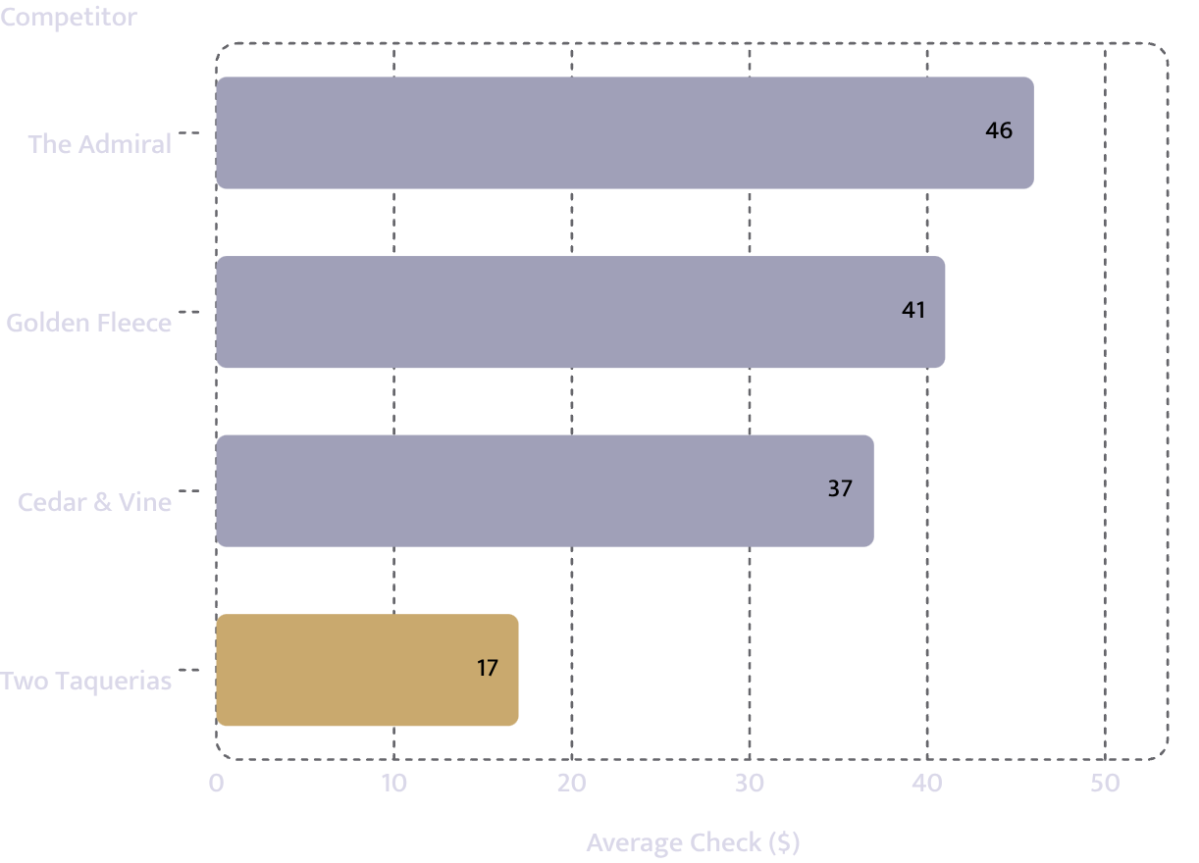

Competition
Price Positioning
Why a Customer Switches
At $37 Cedar & Vine sits $4 below the nearest comparable full-service room and well above the $17 casual floor.
Reservations
Late Weeknight Service
The only room on the block accepting advance bookings — directly addressing documented 50-minute waits at Golden Fleece.
The only kitchen serving full dinner past 9 p.m. on weeknights — an unmet need on the block.

Slide 9
Competition — Continued
Demand & Capacity
The operator's prior 14-month supper club, conducted two blocks away at a $52 fixed price, recorded nine consecutive sell-outs at 40 covers from a 2,100-name list. That evidence pertains to demand rather than competitive response.
Steady-state capacity is calculated at 3,450 covers per month. The model assumes 75% utilisation and a 46% repeat rate once open. Labour and food cost together are projected at 58% of revenue — a combined ratio that must be maintained against price pressure from lower-cost taquerias or cover loss to higher-priced rooms during slower months.
Repeat Rate Assumption
Utilisation at Steady State
46% — based on supper-club experience
75% of 3,450-cover ceiling = 2,600 covers/month
Combined Food & Labour
58% of revenue at steady state

Slide 10
Sales Channels
How Customers Arrive
Primary channel: walk-in traffic supplemented by advance reservations — the key distinction from the two highest-reviewed nearby rooms. The 2,100-name mailing list, corner location, and extended weeknight hours are expected to capture overflow from the 32-seat room three blocks east.
Product mix is projected at 58% dinner food, 30% beverages, and 12% brunch. Repeat business assumed at 46%. A seventh trading day is planned in month 15, once the kitchen team can operate without the chef on every station.
Opening Volume
Steady-State Volume
1,500 covers/month in month 1
2,600 covers/month — 75% utilisation
Seasonality
Marketing Spend
Summer-peak; trough months at 74% of peak
Limited to maintaining the existing mailing list and local visibility — $650/month

Slide 11
Operations
How It Runs
A single 46-seat leased location operating 26 days per month, averaging nine hours per day. Dinner service runs six nights with 1.6 seat turns per evening; weekend brunch adds the balance of volume. Monthly capacity ceiling: 3,450 covers at stabilisation, producing steady-state monthly revenue of $96,200.
Two full-time owner-operators hold 100% of the equity. Eight full-time equivalents total. Key hires: sous chef and bar lead/assistant general manager.
Consultant
CPA
Fixed-fee $9,500 covering build-out and first 90 days of operations
$560/month — monthly closes from month one
Compliance
All zoning approvals in place. Insurance quoted. Personal guarantee provided. No credit issues or bankruptcy history.

Slide 12
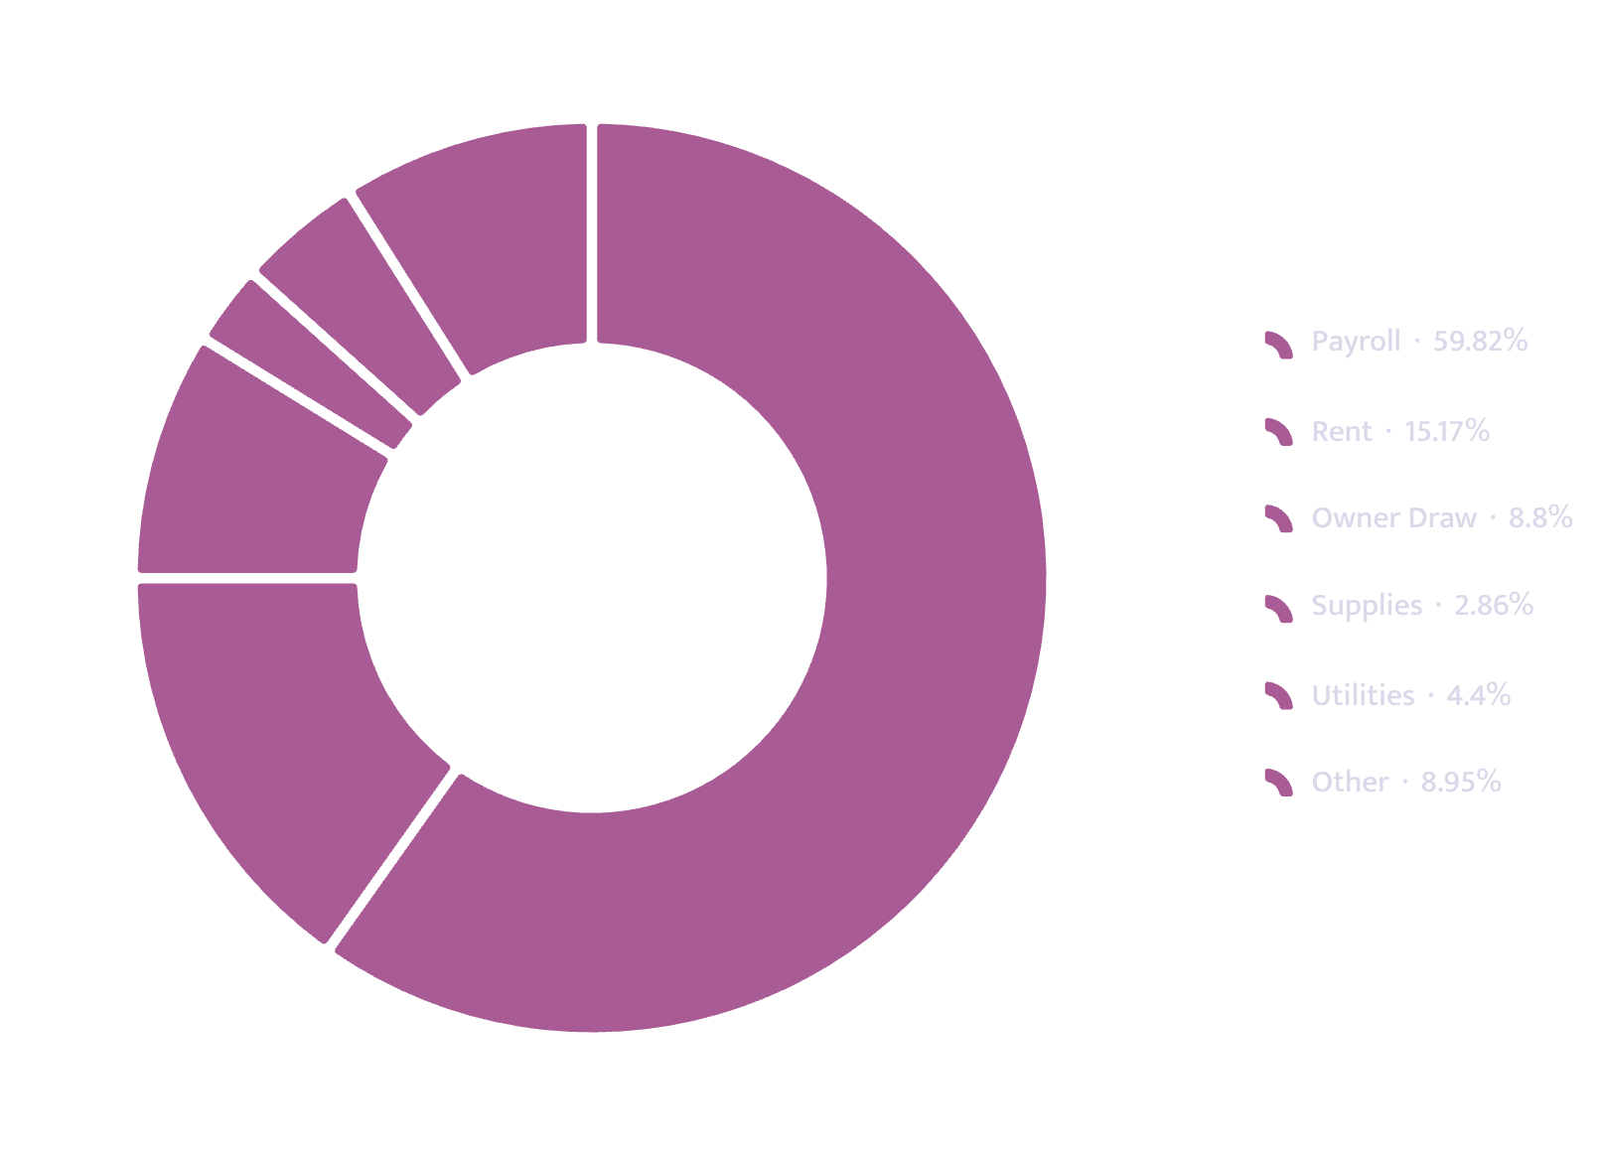
Operations — Continued
Fixed Cost Structure
Fixed monthly operating expenses total $45,470. Variable cost per cover is $11.10, producing a contribution margin of $25.90. Break-even revenue is $70,152, reached in month five.
Monthly debt service is $3,612.98. Debt-service coverage ratios: 1.47 (Year 1), 1.63 (Year 2), 1.73 (Year 3).

Slide 13
Market Reach
Who Is Within Reach
11,800
26
3,450
Catchment Population
Operating Days/Month
Capacity Ceiling
Residents within a 10-minute walk
Units per month
2,600
75%
Steady-State Volume
Utilisation at Steady State
Units per month
Evidence of demand. Ran a monthly supper club in a shared kitchen two blocks away for fourteen months. Every one of the last nine sold out at 40 covers within 48 hours of release, at a $52 fixed price, from a 2,100-name mailing list built with no paid promotion.

Slide 14
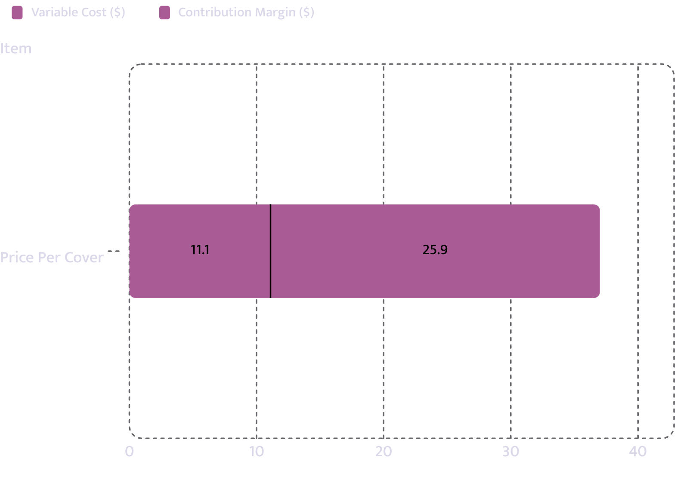
Unit Economics
One Cover — The Unit
Price
Variable Cost
$37.00 per cover (food and drink combined)
$11.10 per cover
Contribution Margin
Cost of Goods
30.0% of revenue
$25.90 per cover

Slide 15
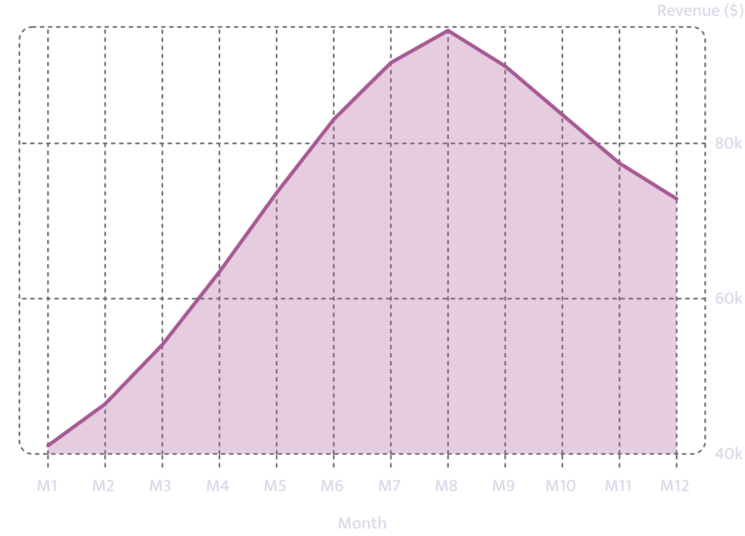
Revenue Model
How Revenue Is Built
Opening Month Volume
Months to Steady State
1,500 units in month 1
8 months from open
Steady-State Volume
Year-1 Revenue
$870,610
2,600 units/month = $96,200/month

Slide 16
Financial Projections
Year 1 — Months 1–6
Month
Units
Revenue
COGS
Gross
EBITDA
Net
1
1,110
$41,070
$12,321
$28,749
$-16,721
$-20,334
2
1,255
$46,435
$13,931
$32,505
$-12,966
$-16,578
3
1,461
$54,057
$16,217
$37,840
$-7,630
$-11,243
4
1,715
$63,455
$19,037
$44,419
$-1,052
$-4,664
5
1,990
$73,630
$22,089
$51,541
$6,071
$2,458
6
2,246
$83,102
$24,931
$58,171
$12,701
$9,088
COGS: Cost of Goods Sold | EBITDA: Earnings Before Interest, Taxes, Depreciation & Amortisation. Break-even is reached in month 5 — the first month with positive net income.

Slide 17
Financial Projections
Year 1 — Months 7–12
Month
Units
Revenue
COGS
Gross
EBITDA
Net
7
2,443
$90,391
$27,117
$63,274
$17,804
$14,191
8
2,555
$94,535
$28,361
$66,175
$20,705
$17,092
9
2,431
$89,947
$26,984
$62,963
$17,493
$13,880
10
2,262
$83,694
$25,108
$58,586
$13,116
$9,503
11
2,093
$77,441
$23,232
$54,209
$8,739
$5,126
12
1,969
$72,853
$21,856
$50,997
$5,527
$1,914
Year 1
23,530
$870,610
$261,183
$609,427
$63,787
$20,431
COGS: Cost of Goods Sold | EBITDA: Earnings Before Interest, Taxes, Depreciation & Amortisation. Seasonality visible in months 9–12 as volume moderates from the summer peak.

Slide 18
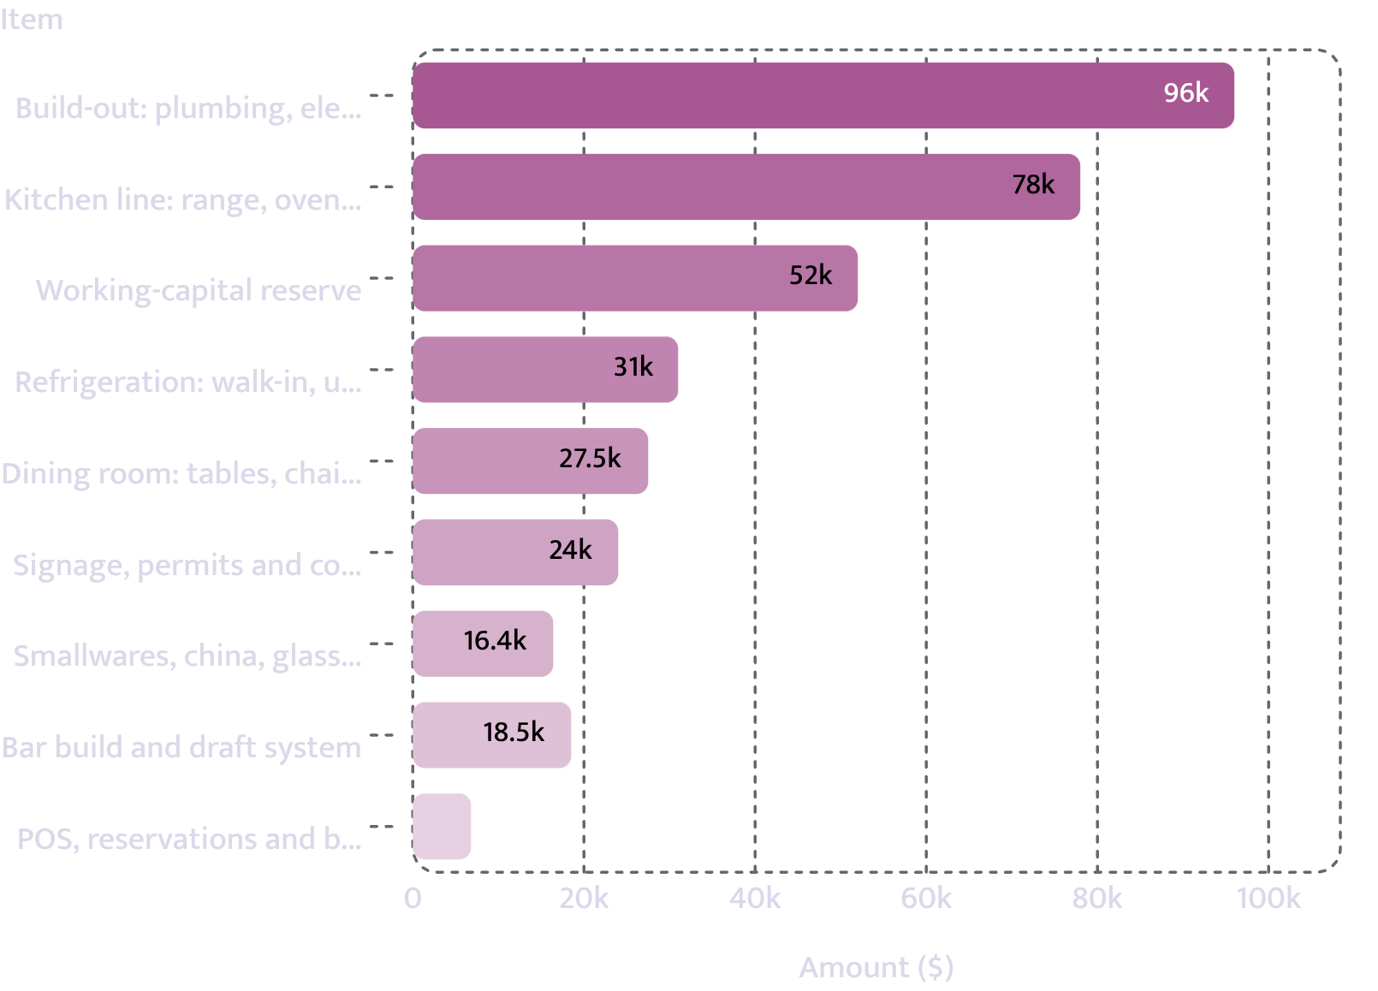
Startup Costs
What It Costs to Open the Doors
Capital Expenditure
Working-Capital Reserve
$298,200 — based on contractor quotes and operator estimates
$52,000 — operator-funded
Total Requirement
$350,200

Slide 19
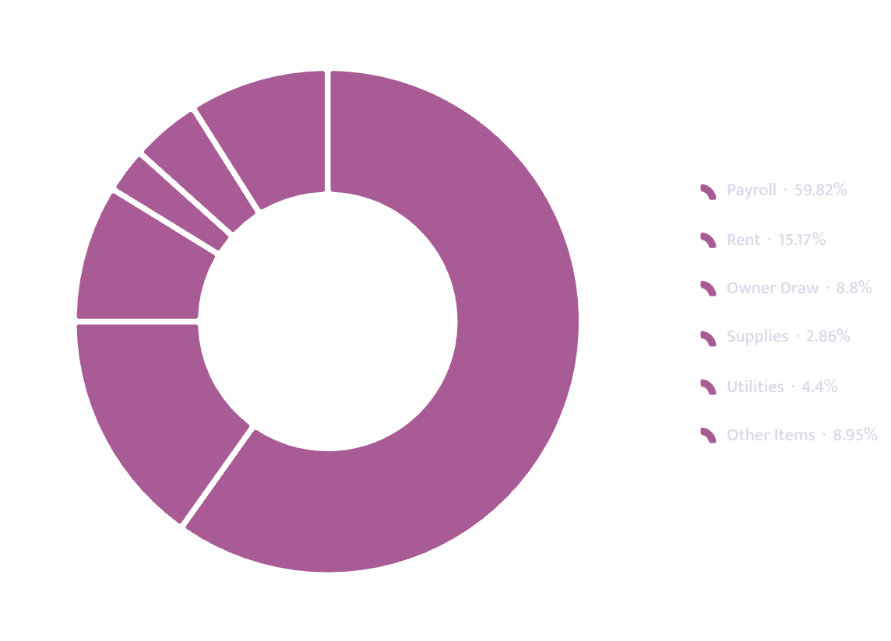
Ongoing Costs
What It Costs to Stay Open
Fixed Monthly Cost
Amount
Payroll
$27,200
Rent
$6,900
Owner Draw
$4,000
Supplies
$1,300
Utilities
$2,000
Maintenance
$780
Insurance
$1,080
Accounting
$560
Marketing
$650
Software
$480
Other
$520
Total Fixed Monthly
$45,470

Slide 20
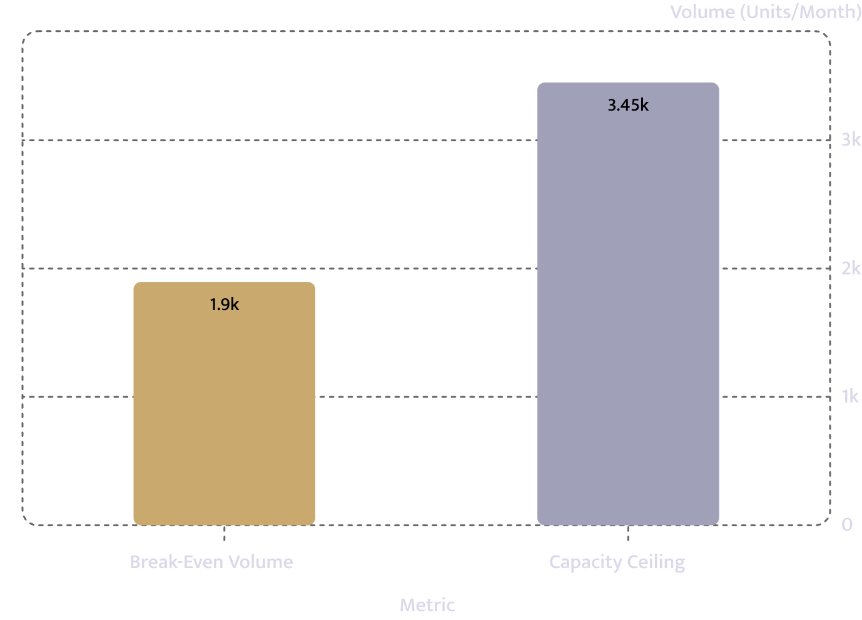
Break-Even Analysis
Break-Even at Month 5
Fixed Costs + Debt Service
Contribution Per Unit
$25.90
$49,083/month
Break-Even Volume
Break-Even Revenue
1,896 units/month
$70,152/month
Headroom at Capacity
55.0% of capacity required — 45% of capacity remains as buffer

Slide 21
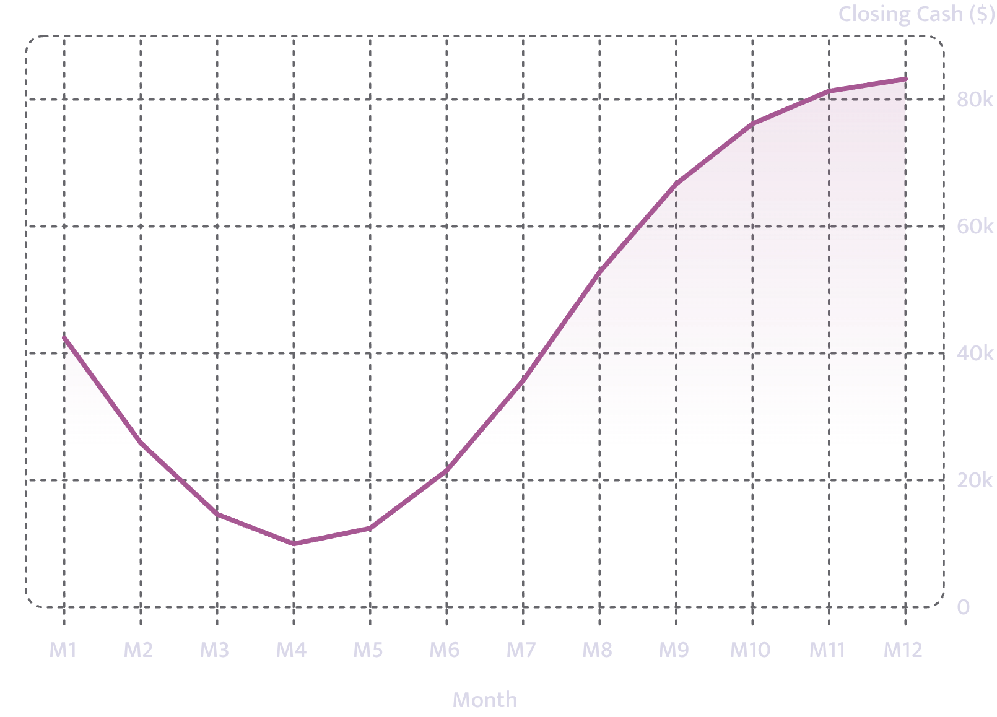

Cash Position
Cash Across Year 1
Opening cash after startup spend: $62,800.
Cash trough is $9,980 in month 4 — the most constrained point of the ramp. Any shortfall in assumed 75% utilisation or 46% repeat rate would extend negative cash flow beyond the $52,000 working-capital reserve.
From month 5 onward, cash recovers consistently. Closing cash reaches $83,231 by month 12.

Slide 22
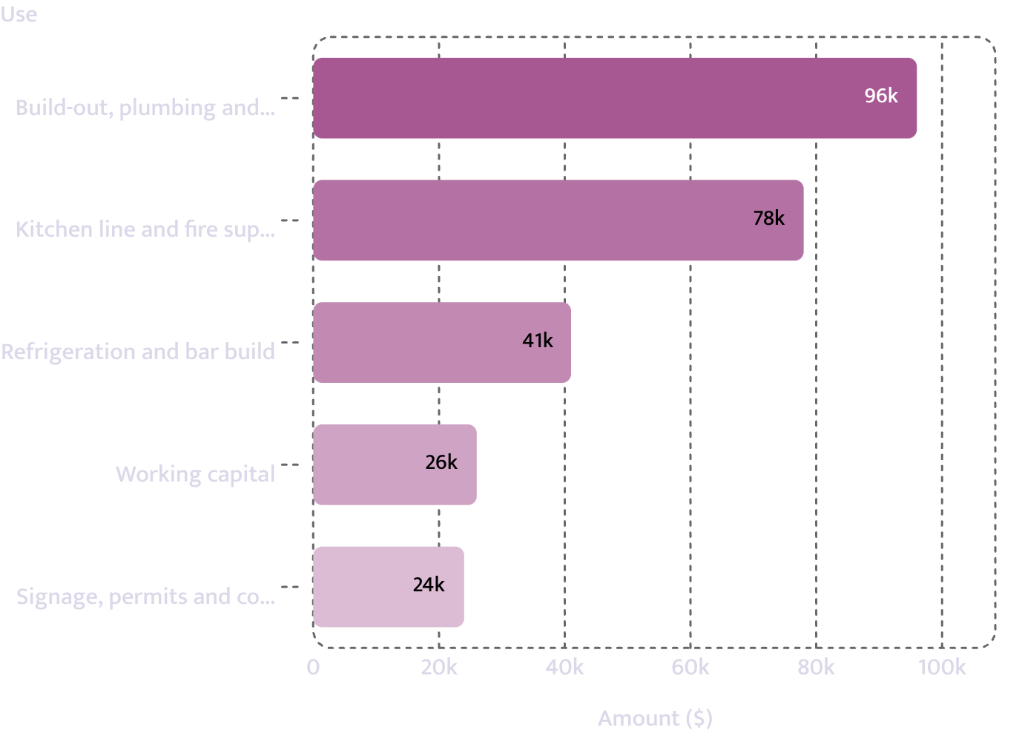
Use of Funds
Use of Loan Proceeds
Use
Amount
Build-out, plumbing and compliance
$96,000
Kitchen line and fire suppression
$78,000
Refrigeration and bar build
$41,000
Signage, permits and contingency
$24,000
Working capital
$26,000
Total
$265,000
Uses total exactly the loan amount requested.

Slide 23
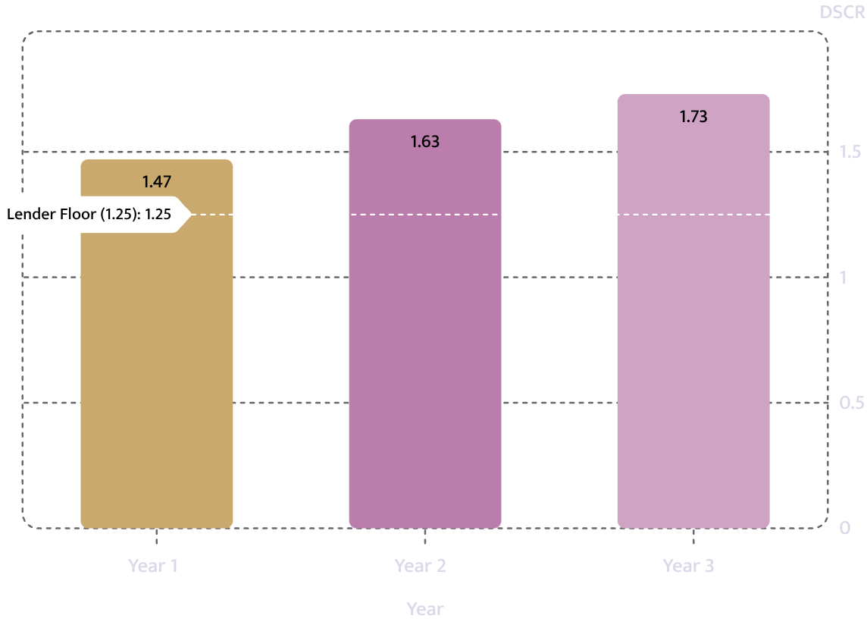
Debt Service Coverage
DSCR — Above the 1.25 Floor
DSCR: Debt Service Coverage Ratio — net operating income divided by total annual debt service. A ratio above 1.25 is the stated lender floor.
Coverage improves year-over-year as volume stabilises. These ratios leave limited margin for cost overruns or slower volume growth.
Year 1
Year 2
Year 3
1.47 vs. 1.25 floor
1.63 vs. 1.25 floor
1.73 vs. 1.25 floor

Slide 24
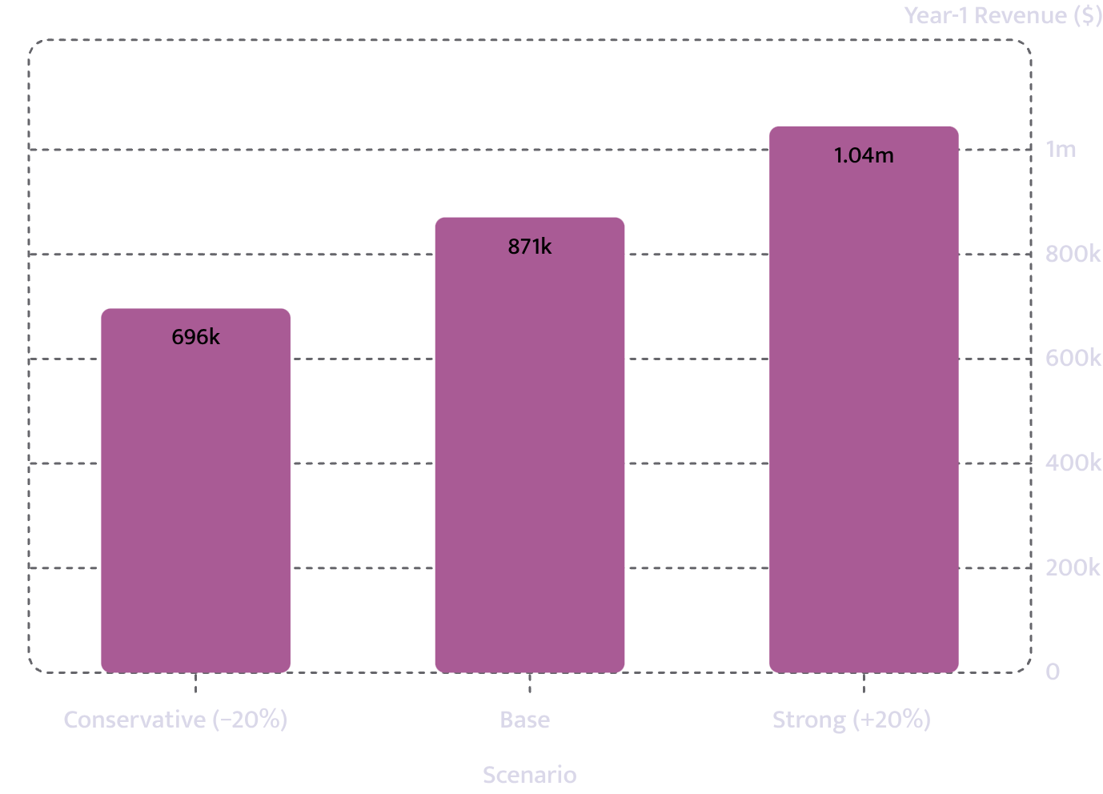

Scenario Analysis
If Volume Comes In 20% Under
Scenario
Year-1 Revenue
Cash Low Point
Year-1 DSCR
Conservative (−20%)
$696,451
$-38,680
-1.34
Base
$870,610
$9,980
1.47
Strong (+20%)
$1,044,695
$34,458
4.28
A 20% volume shortfall produces a negative DSCR of -1.34 and a cash low point of $-38,680 — exhausting the working-capital reserve. DSCR: Debt Service Coverage Ratio.

Slide 25
Industry Benchmarks
How the Numbers Compare to Industry
Ratio
This Plan
Industry Band
Status
Source
Cost of Goods
30.0%
28–35%
Inside
National Restaurant Association, industry operations reporting, 2025
Rent
7.2%
6–10%
Inside
National Restaurant Association, industry operations reporting, 2025
Payroll
28.3%
28–36%
Inside
US Bureau of Labor Statistics, Current Employment Statistics, 2025
Every band is cited. All three ratios fall within their respective industry ranges. A ratio outside its band is not necessarily wrong — it is what an underwriter will ask about first.

Slide 26
Licensing
Licensing & Permits
Licence or Permit
Status
Cost
Lead Time
Note
Food service establishment permit
Applied
$700
8 weeks
In progress
Certificate of occupancy
Not started
$500
10 weeks
Longest lead time
Food manager certification
Held
$180
1 week
Valid through 2029
Sales tax permit
Held
$0
2 weeks
Complete
Sign permit
Not started
$250
3 weeks
Pending
Grease trap compliance
Applied
$400
4 weeks
In progress
Held
Applied
Not Started
Food manager cert + Sales tax permit
Food service permit + Grease trap compliance
Certificate of occupancy + Sign permit

Slide 27
Key Principles
What Makes or Breaks a Restaurant
Food cost and labour cost together decide whether the model works
Seat turnover per day-part is the capacity ceiling — not the seat count
Either ratio in isolation is meaningless. Combined, they must be controlled at every volume level — not just at steady state. This plan projects a combined 58% of revenue.
46 seats with 1.6 dinner turns is 73.6 effective dinner covers per evening. That is the operational limit before hours or staffing must expand. Brunch covers fill the weekend gap.

Slide 28

Management
Who Is Running It
The Gap They Know About
Renata Alvarez — Executive Chef (60%)
Tobias Lindqvist — Front of House (40%)
Neither owner has previously opened a room from an empty shell. Addressed by:
12 years in restaurant kitchens: line then sous at Rhubarb in Asheville, then four years as executive chef of a 70-seat Charleston independent with full food and labour cost responsibility.
Six years managing front of house and the bar programme at a 90-cover Raleigh restaurant.
Restaurant Consultant
CPA
Fixed-fee $9,500 — build-out and first 90 days
$560/month — monthly closes from month one

Slide 29



Management — Continued
The Full Team
Both owners work full time, each with prior experience managing profit-and-loss statements. Combined, they bring 18 years of kitchen and front-of-house management in multi-cover independent restaurants.
Planned key hires: a sous chef and a bar lead who will also act as assistant general manager. One owner holds a ServSafe food protection manager certification valid through 2029. Total planned headcount: 8 full-time equivalents.
Renata Alvarez
Executive Chef — 60% owner. Rhubarb (Asheville), 70-seat Charleston independent.
Tobias Lindqvist
Front of House & Bar — 40% owner. 90-cover Raleigh restaurant, 6 years.
CPA + Consultant
Monthly closes and 90-day build-out support. External accountability from day one.

Slide 30

Risk Assessment
Risks & Mitigations
Extended Cash Ramp
Lease Exposure
Cash trough of $9,979.98 in month four. Break-even not until month five. A shortfall in 75% utilisation or 46% repeat rate extends negative cash flow beyond the $52,000 working-capital reserve.
84-month agreement, personal guarantee, 3% annual escalations, and $6,900/month rent (7.17% of steady-state revenue). Early termination creates direct personal recourse.
New-Unit Inexperience
Demand Evidence Limitations
Neither owner has managed a build-out from shell space. Mitigated by fixed-fee consultant engagement covering construction and first 90 days, plus CPA monthly closes from month one.
Supper-club results occurred in a different format and location. No third-party demand study supplied.

Slide 31

Risk Assessment — Continued
Coverage & Collateral
DSCR Year 1
1.47 — leaves limited margin for cost overruns or slower volume growth
Collateral
Equipment and fit-out items: aggregate value $155,000. Balance of requested loan is unsecured beyond the personal guarantee.
Collateral Gap
$155K equipment covers part; remainder PG only
Coverage Margin
DSCR 1.47 Year 1; thin buffer above 1.25
Seasonality Risk
Cannot be fully quantified from available data. Plan assumes a seventh trading day in Year 2 to offset summer-peak dependence — not yet tested.
Seasonality Risk
Trough at 74% of peak; day seven untested
Competitive Pressure
Additional volume risk from lower-cost taquerias and higher-priced rooms during slower months.

Slide 32
Key Assumptions
Assumptions — Sensitivity
Every figure is either operator-supplied, document-confirmed, or a benchmark default with its source named. The final column shows the impact if the assumption proves 20% worse.
Assumption
Value
Source
If 20% Worse
Price per unit
$37
Operator-provided
DSCR 1.47 → -2.54; cash low $-90,891
Variable cost per unit
$11.10
Operator-provided
DSCR 1.47 → 0.27; cash low $-4,281
Steady-state volume
2,600 units/mo
Operator-provided
DSCR 1.47 → -0.75; cash low $-13,143
Monthly payroll (excl. owners)
$27,200
Operator-provided
DSCR 1.47 → -0.03; cash low $-14,762
Monthly rent
$6,900
Confirmed from lease
DSCR 1.47 → 1.09; cash low $4,460

Slide 33
Key Assumptions — Continued
Industry-Band Assumptions
Assumption
Value
Source
If 20% Worse
Cost of goods as % of revenue
30.0%
Industry band 28–35% — National Restaurant Association, industry operations reporting, 2025
Inside the band
Rent as % of revenue
7.2%
Industry band 6–10% — National Restaurant Association, industry operations reporting, 2025
Inside the band
Payroll as % of revenue
28.3%
Industry band 28–36% — US Bureau of Labor Statistics, Current Employment Statistics, 2025
Inside the band
All three industry-benchmarked ratios remain within their cited bands even under a 20% adverse movement. These are the least sensitive assumptions in the model.

Slide 34
Summary
The Request, Restated
$265K
27.4%
Loan Requested
Owner Injection
120 months at 10.75%
$96,000 of $350,200 total project cost
1,896
1.47
Break-Even Volume
Year-1 DSCR
55.0% of capacity — reached in month 5
Against a 1.25 lender floor
DSCR: Debt Service Coverage Ratio. All figures are as submitted. No projections beyond the stated three-year period are implied.

