Slide 1
Harbor Lane Coffee · Business Plan & Funding Request · SBA 7(a)
Harbor Lane
Coffee
Business Plan and Funding Request · Inner South-East Portland, Oregon
SBA 7(a) / Microloan · Prepared for Bank Underwriter under SBA Standard Operating Procedure
Source: Harbor Lane Coffee LLC · Slide 1/31 · Confidential

Slide 2

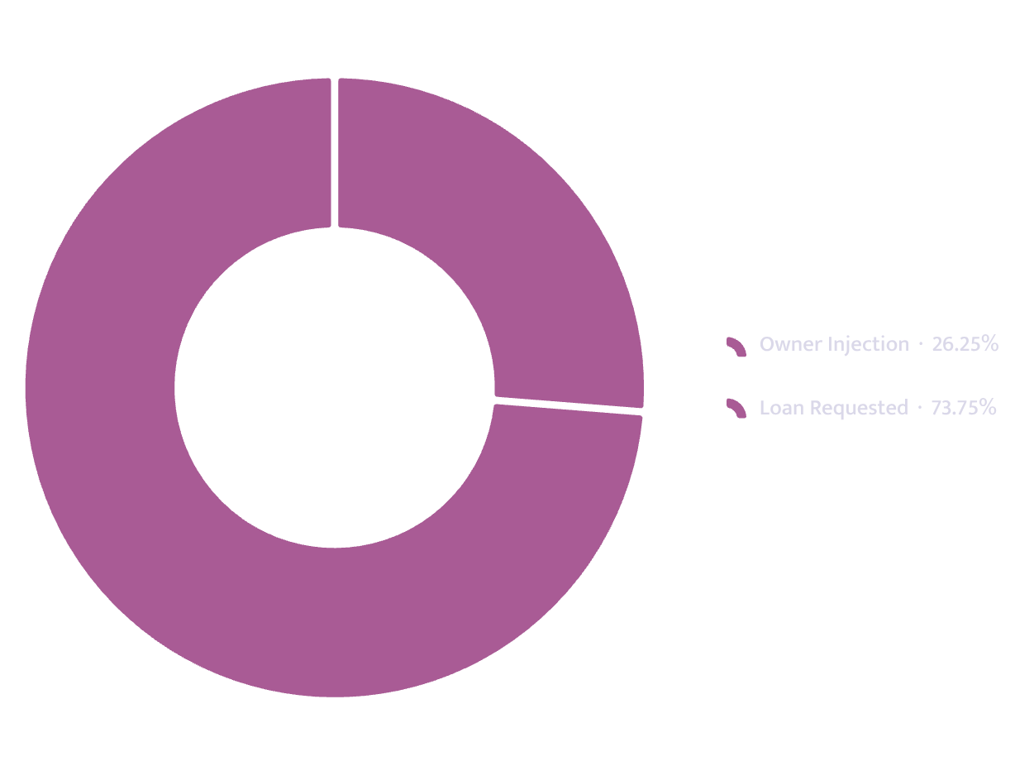
FUNDING REQUEST
The Request
Loan requested
$118,000
Owner injection
$42,000 — 32.8% of project cost
Total startup requirement
$128,000
Term
120 months at 11.25%
Monthly debt service
$1,642
Year-1 DSCR
1.92 against a 1.25 floor
DSCR: Debt Service Coverage Ratio
Total project cost: $128,000
Source: Harbor Lane Coffee LLC · Slide 2/31 · Confidential

Slide 3
EXECUTIVE SUMMARY
The Plan in Six Numbers
$444K
4,487
Year-1 Revenue
Break-Even Volume
Units per month
6
57.5%
Month Break-Even Reached
Capacity at Break-Even
$46K
$5.75
Cash Low Point
Contribution Per Unit
Month 5
Source: Harbor Lane Coffee LLC · Slide 3/31 · Confidential

Slide 4
SECTION I
01
The Business
Entity structure, location, and operational footprint
Source: Harbor Lane Coffee LLC · Slide 4/31 · Confidential

Slide 5


THE BUSINESS → ENTITY
The Business
Entity
Seating
Harbor Lane Coffee LLC — Oregon limited liability company, formed April 2, 2026.
18 seats within the unit.
Lease
Ownership
Five-year term with personal guarantee from both owners.
Dana Whitfield 70% · Marcus Oyelaran 30%
Trade name
Location
Operates as Harbor Lane Coffee — single unit, no franchise relationship.
Single-unit neighbourhood espresso bar, leased corner space, inner south-east Portland, Oregon.
Source: Harbor Lane Coffee LLC · Slide 5/31 · Confidential

Slide 6
THE BUSINESS → MARKET
The Market
Demand evidence
9,400
2 floors + 140 desks
Residents within a ten-minute walk
An eleven-week weekend pop-up on the same corner in 2025 averaged 118 transactions per day with only a sandwich board for promotion.
No paid advertising. No signage beyond a sandwich board. Temporary vendor permit only.
Co-working floors and a design studio within two blocks
2,600–3,100
Weekday bicycle passes recorded by city counter two doors away
Source: Harbor Lane Coffee LLC · Slide 6/31 · Confidential

Slide 7

THE BUSINESS → CUSTOMERS
Who Is Within Reach
Catchment population
9,400
Demand evidence: An eleven-week pop-up from the same corner averaged 118 transactions per day in 2025 with no marketing beyond a sandwich board. Operated under a temporary vendor permit.
Operating days / month
26
Capacity ceiling
7,800 units/month
Capacity ceiling derived from three baristas during morning rush, two thereafter, across 10-hour operating days.
Steady-state volume
6,200 units/month
Utilisation at steady state
79.0%
Source: Harbor Lane Coffee LLC · Slide 7/31 · Confidential

Slide 8
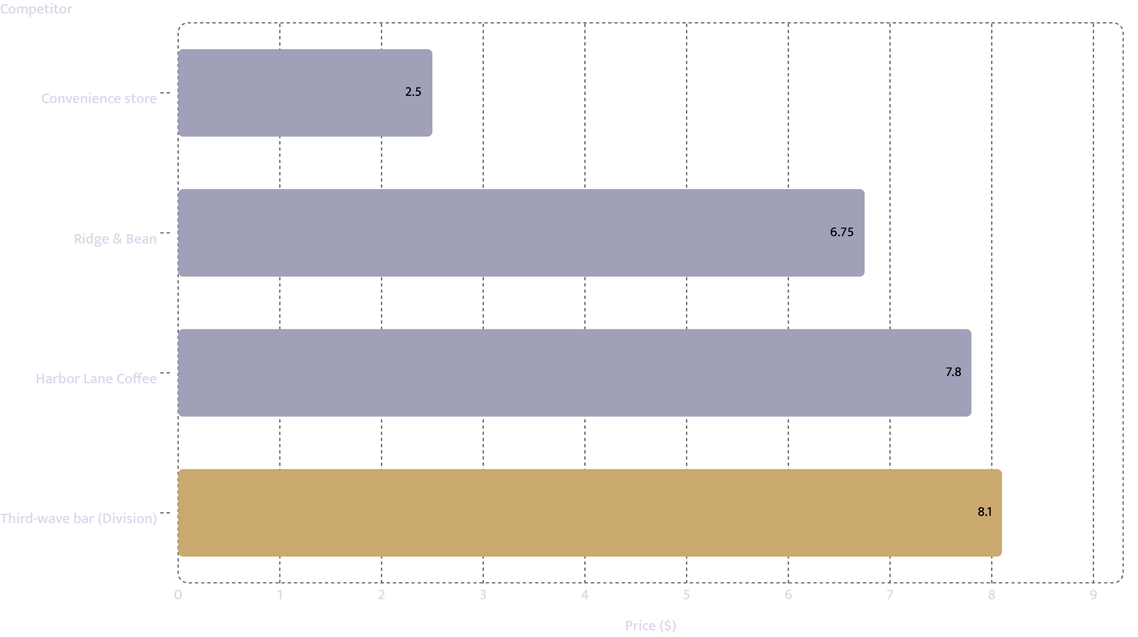
THE BUSINESS → COMPETITION
Named Competitors and What They Charge
Competitor
Price
Note
Ridge & Bean, 4 blocks north
$6.75
Eight years trading, strong regulars — no seating, closes at 2pm
Coava-style third-wave bar on Division
$8.10
Twelve-minute walk; queues at peak hours
Convenience store self-serve
$2.50
Different customer segment; sets the price floor
Harbor Lane Coffee
$7.80
Only sit-down option on the corner; only one open past 2pm
Source: Harbor Lane Coffee LLC · Slide 8/31 · Confidential

Slide 9
THE BUSINESS → CUSTOMER ACQUISITION
How Customers Arrive
The plan relies on walk-in traffic from the corner location rather than paid acquisition. No marketing budget beyond $250 per month is projected.
Co-working floors
Design studio
140-desk studio within two blocks
Two floors within two blocks
9,400 residents
2,600–3,100 passes/day
118 transactions/day
Within a ten-minute walk — primary daytime base
Weekday bicycle count recorded at the site
Documented pop-up average, same corner, 2025 — no paid advertising
Source: Harbor Lane Coffee LLC · Slide 9/31 · Confidential

Slide 10


THE BUSINESS → OPERATIONS
How It Runs
7,800
Lease
$4,100/month base rent · 3% annual escalation · personal guarantees from both owners
Capacity ceiling — transactions per month
Operating schedule
Steady-state target: 6,200 units/month · 79.0% utilisation
26 days per month · 10 hours daily
Staffing model
Three baristas during morning rush · two thereafter
Source: Harbor Lane Coffee LLC · Slide 10/31 · Confidential

Slide 11
SECTION II
02
The Financials
Unit economics, revenue build, cost structure, and debt service coverage
Source: Harbor Lane Coffee LLC · Slide 11/31 · Confidential

Slide 12
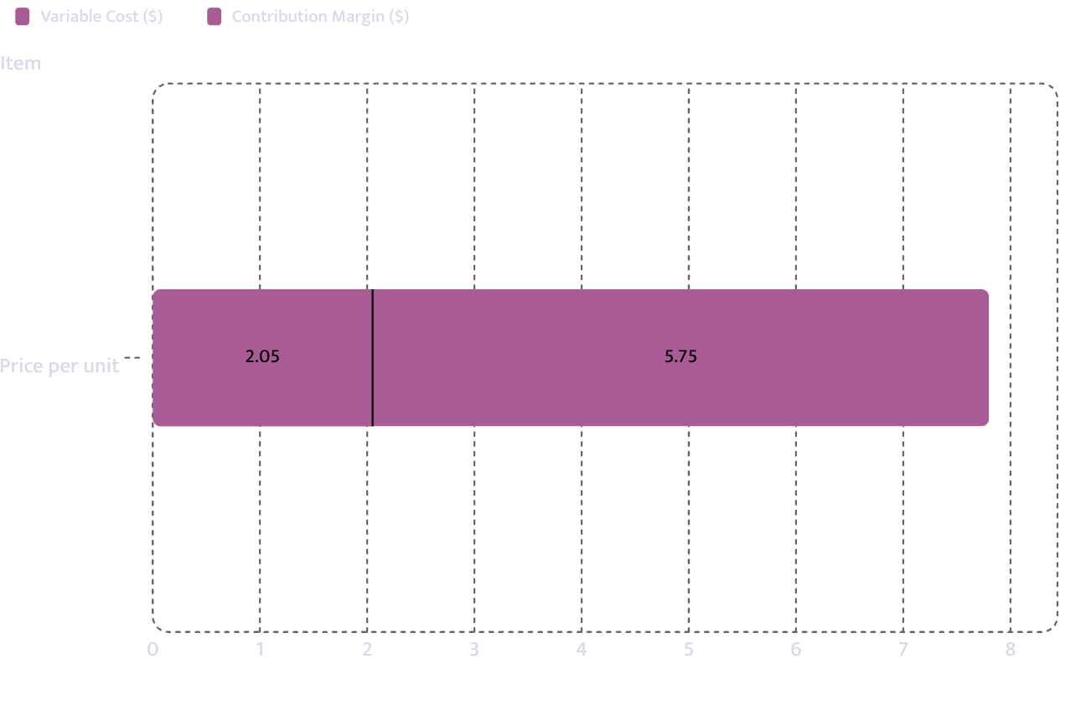
FINANCIALS → UNIT ECONOMICS
Unit Economics
One customer transaction — a drink, and about half the time a food item as well
Price
$7.80
Variable cost
$2.05
Contribution margin
$5.75
COGS as % of revenue
26.3%
COGS: Cost of Goods Sold
Source: Harbor Lane Coffee LLC · Slide 12/31 · Confidential

Slide 13
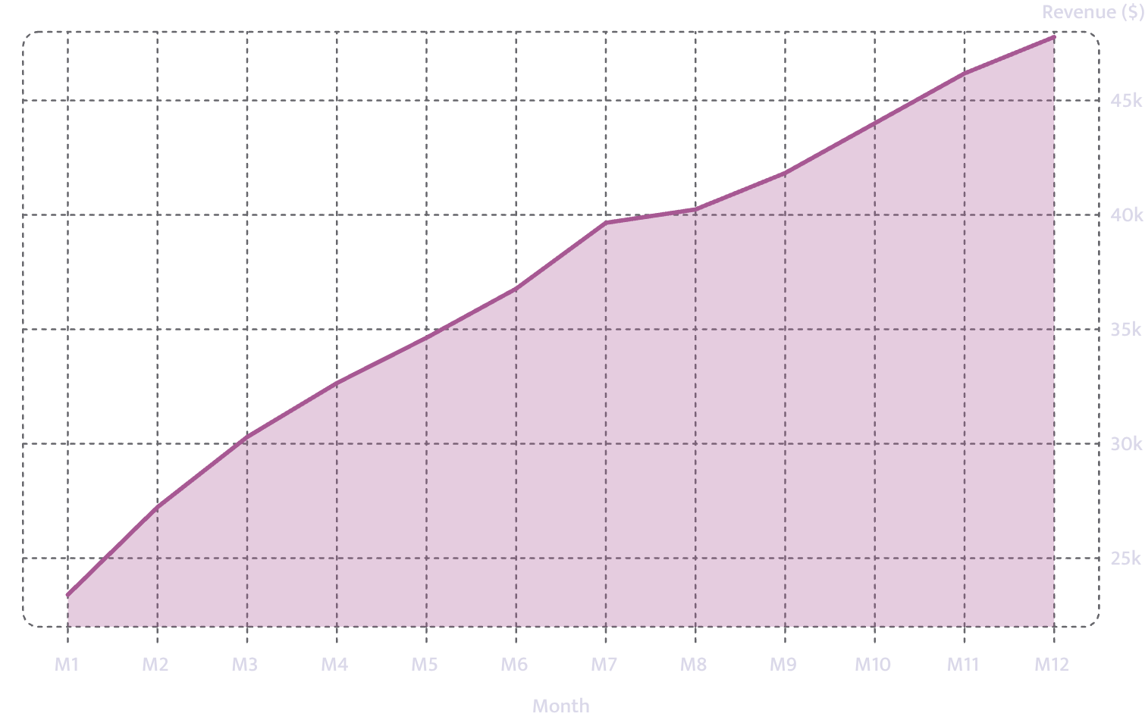
FINANCIALS → REVENUE BUILD
How Revenue Is Built
Opening month volume
3,000 units
Months to steady state
7
Steady-state volume
6,200 units/month
Steady-state revenue
$48,360/month
Year-1 revenue
$444,678
Source: Harbor Lane Coffee LLC · Slide 13/31 · Confidential

Slide 14
FINANCIALS → MONTHLY P&L · MONTHS 1–6
Year 1 — Months 1 to 6
Month
Units
Revenue
COGS
Gross
EBITDA
Net
1
3,000
$23,400
$6,150
$17,250
$-6,907
$-8,549
2
3,491
$27,230
$7,157
$20,073
$-4,084
$-5,726
3
3,884
$30,295
$7,962
$22,333
$-1,824
$-3,466
4
4,186
$32,651
$8,581
$24,070
$-88
$-1,730
5
4,440
$34,632
$9,102
$25,530
$1,373
$-269
6
4,715
$36,777
$9,666
$27,111
$2,954
$1,312
COGS: Cost of Goods Sold · EBITDA: Earnings Before Interest, Taxes, Depreciation & Amortisation · Source: Harbor Lane Coffee LLC · Slide 14/31 · Confidential

Slide 15
FINANCIALS → MONTHLY P&L · MONTHS 7–12
Year 1 — Months 7 to 12
Month
Units
Revenue
COGS
Gross
EBITDA
Net
7
5,084
$39,655
$10,422
$29,233
$5,076
$3,434
8
5,159
$40,240
$10,576
$29,664
$5,507
$3,865
9
5,363
$41,831
$10,994
$30,837
$6,680
$5,038
10
5,642
$44,008
$11,566
$32,442
$8,285
$6,642
11
5,921
$46,184
$12,138
$34,046
$9,889
$8,247
12
6,125
$47,775
$12,556
$35,219
$11,062
$9,420
Year 1 total
57,010
$444,678
$116,871
$327,808
$37,924
$18,217
COGS: Cost of Goods Sold · EBITDA: Earnings Before Interest, Taxes, Depreciation & Amortisation · Source: Harbor Lane Coffee LLC · Slide 15/31 · Confidential

Slide 16
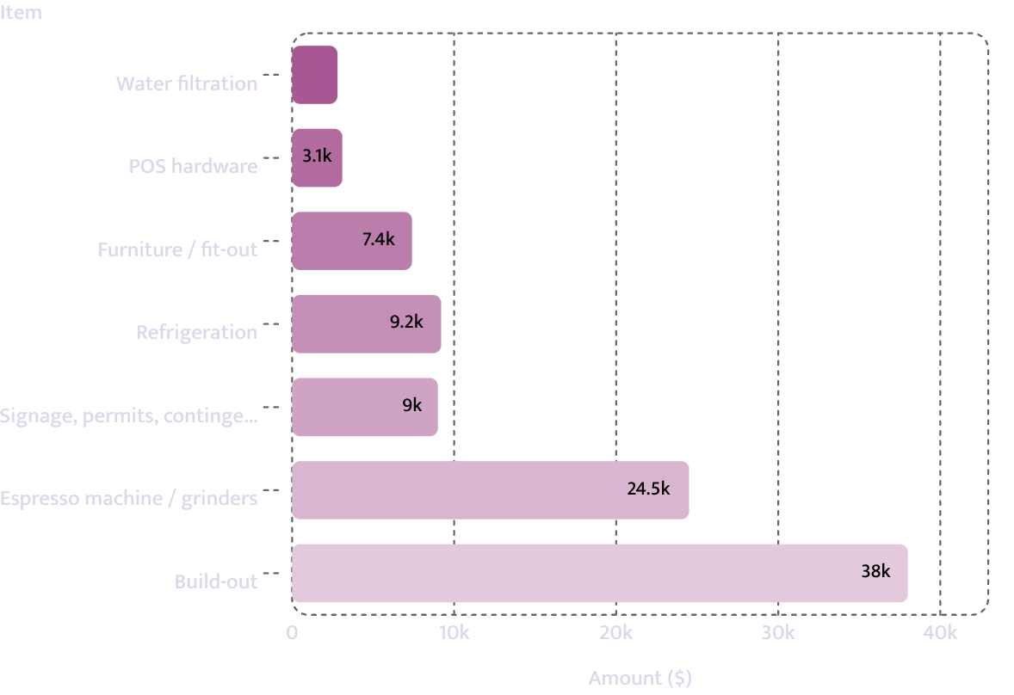
FINANCIALS → STARTUP COSTS
What It Costs to Open the Doors
Item
Amount
Espresso machine and grinders
$24,500
Build-out: counter, plumbing, sink, grease trap
$38,000
Refrigeration (undercounter and display)
$9,200
Furniture and fit-out — 18 seats
$7,400
POS hardware and card terminals
$3,100
Water filtration and plumbing compliance
$2,800
Signage, permits, and contingency
$9,000
Capital expenditure
$94,000
Working-capital reserve
$34,000
Total requirement
$128,000
POS: Point of Sale · Source: Harbor Lane Coffee LLC · Slide 16/31 · Confidential

Slide 17
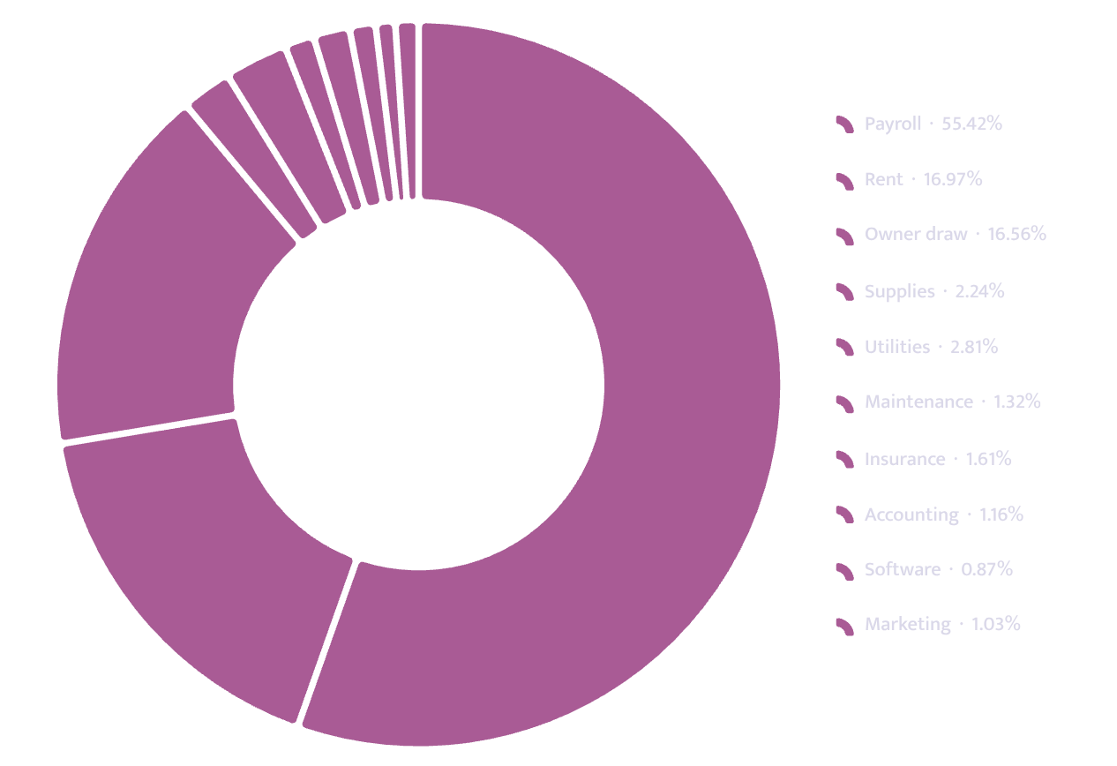
FINANCIALS → OPERATING COSTS
What It Costs to Stay Open
Fixed monthly cost
Amount
Rent
$4,100
Payroll
$13,387
Owner draw
$4,000
Utilities
$680
Insurance
$390
Marketing
$250
Software
$210
Accounting
$280
Maintenance
$320
Supplies
$540
Total fixed monthly
$24,157
Source: Harbor Lane Coffee LLC · Slide 17/31 · Confidential

Slide 18
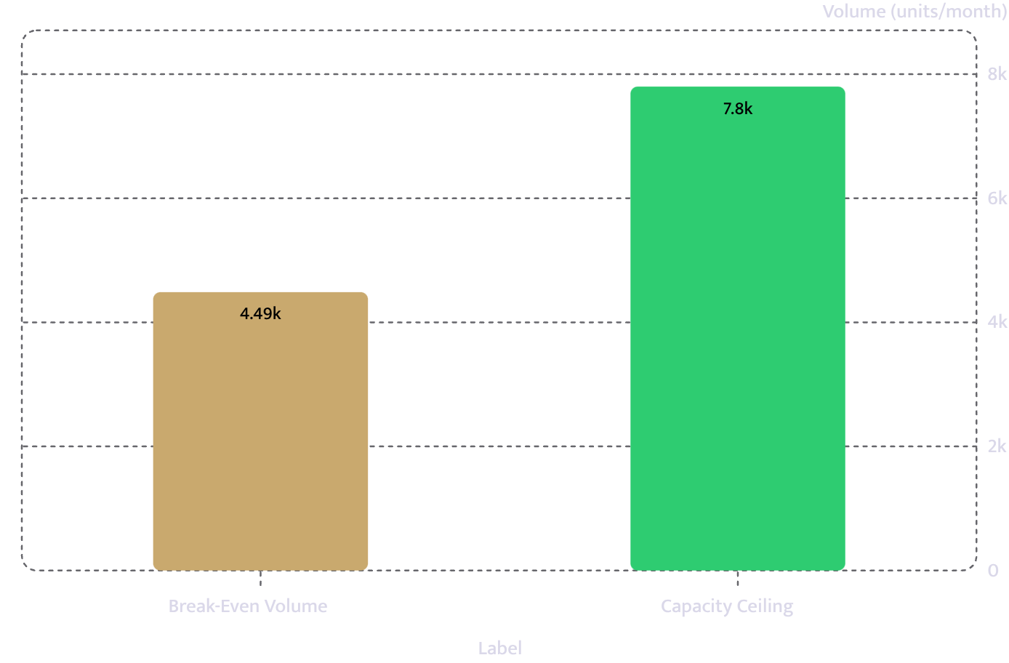
FINANCIALS → BREAK-EVEN
Break-Even
Fixed costs plus debt service
$25,799/month
Contribution per unit
$5.75
Break-even volume
4,487 units/month
Break-even revenue
$34,999
Capacity ceiling
7,800 units/month
Headroom
57.5% of capacity required
Break-even reached in month 6.
Headroom of 3,313 units separates break-even from capacity
Source: Harbor Lane Coffee LLC · Slide 18/31 · Confidential

Slide 19
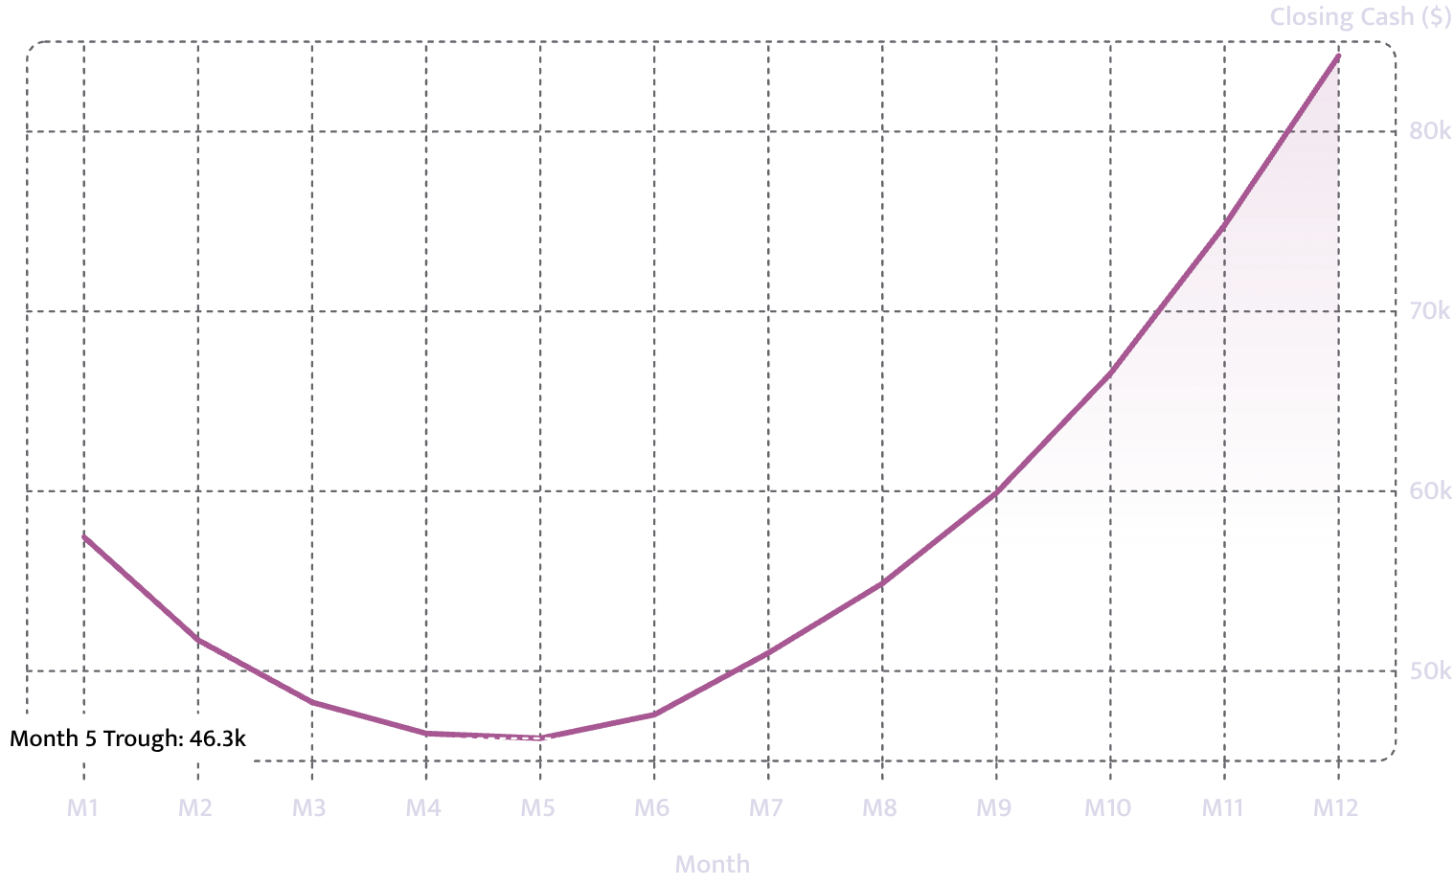
FINANCIALS → CASH POSITION
Cash Across Year 1
$46,260
Cash low point — Month 5
Opening cash after startup spend: $66,000. Cash recovers steadily from month 6 onward.
Source: Harbor Lane Coffee LLC · Slide 19/31 · Confidential

Slide 20
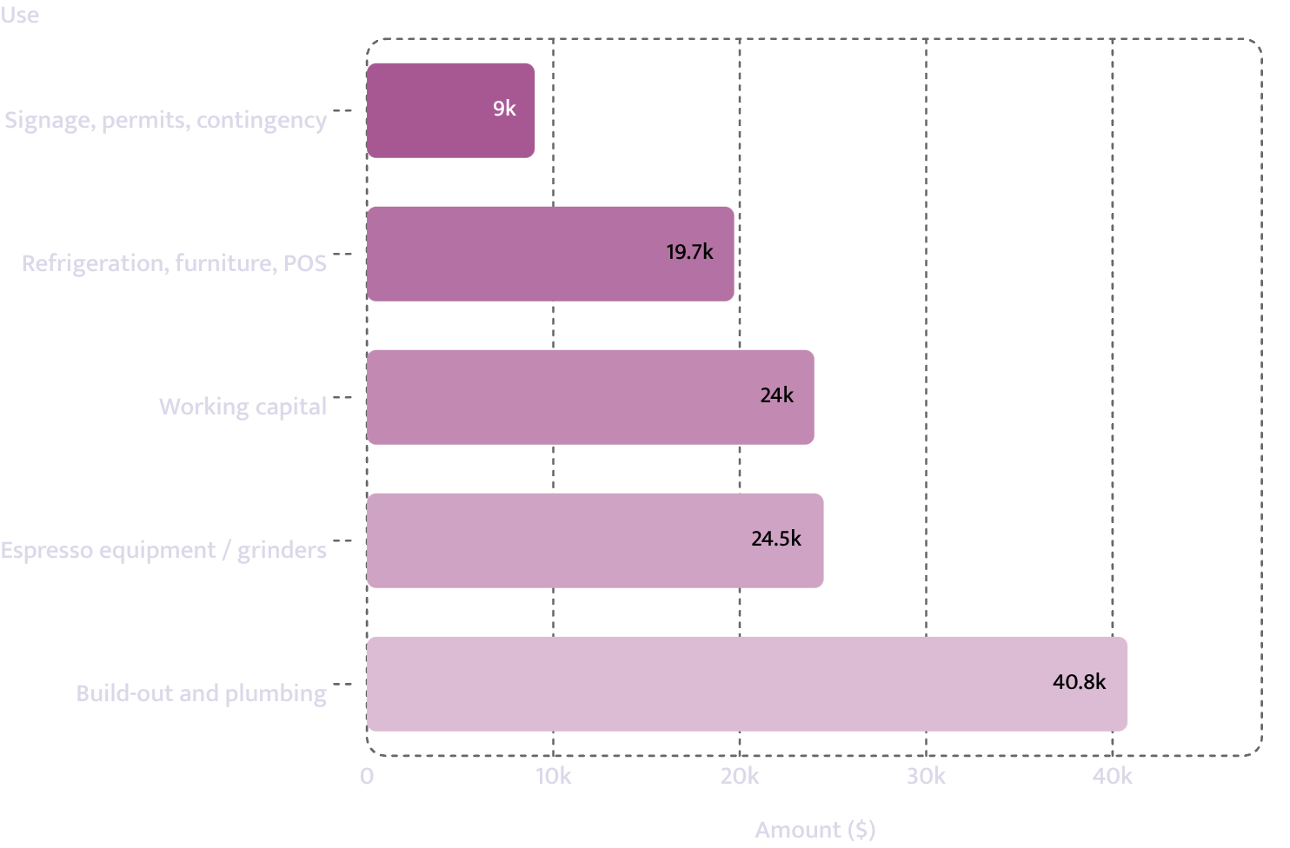
FINANCIALS → USE OF FUNDS
Use of Funds
Use
Amount
Build-out and plumbing compliance
$40,800
Espresso equipment and grinders
$24,500
Refrigeration, furniture and POS
$19,700
Signage, permits and contingency
$9,000
Working capital
$24,000
Total
$118,000
POS: Point of Sale. Uses total exactly the amount requested.
Source: Harbor Lane Coffee LLC · Slide 20/31 · Confidential

Slide 21
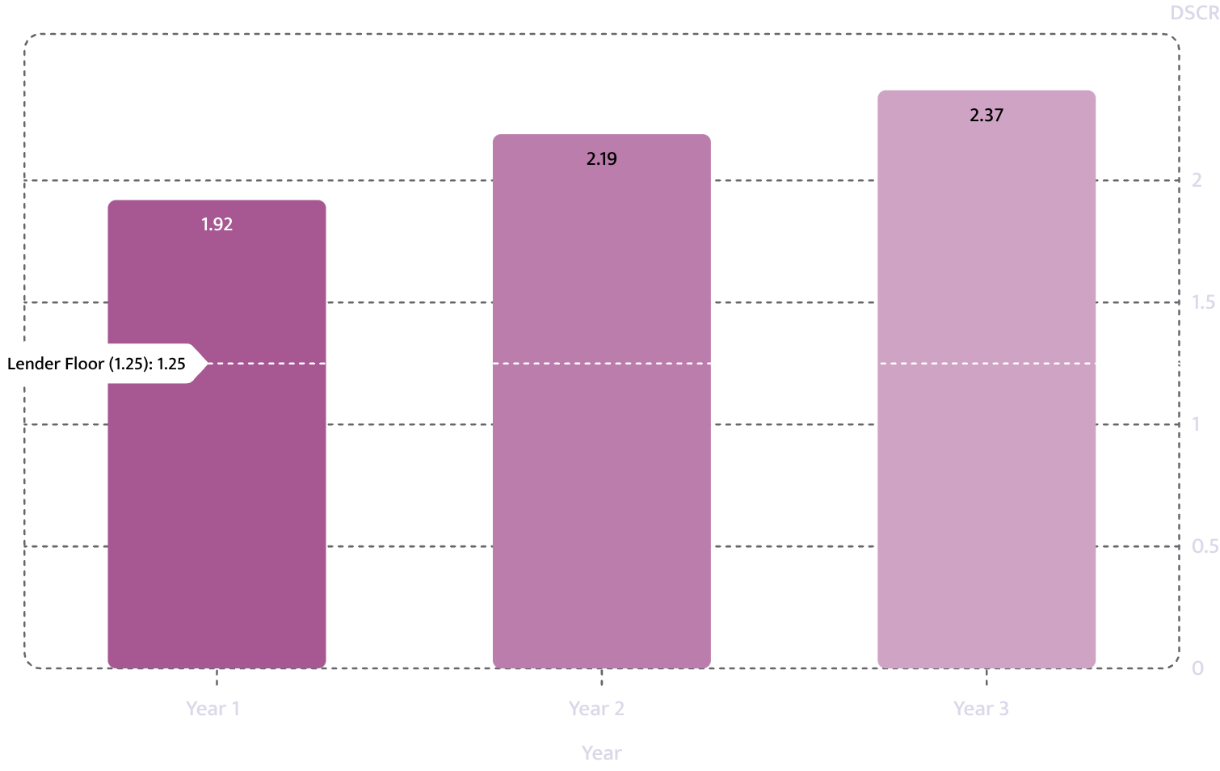
FINANCIALS → DEBT SERVICE COVERAGE
Debt Service Coverage
Year 1
Year 2
Year 3
DSCR
1.92
2.19
2.37
Lender floor
1.25
1.25
1.25
DSCR: Debt Service Coverage Ratio. All three years clear the 1.25 lender floor.
Source: Harbor Lane Coffee LLC · Slide 21/31 · Confidential

Slide 22
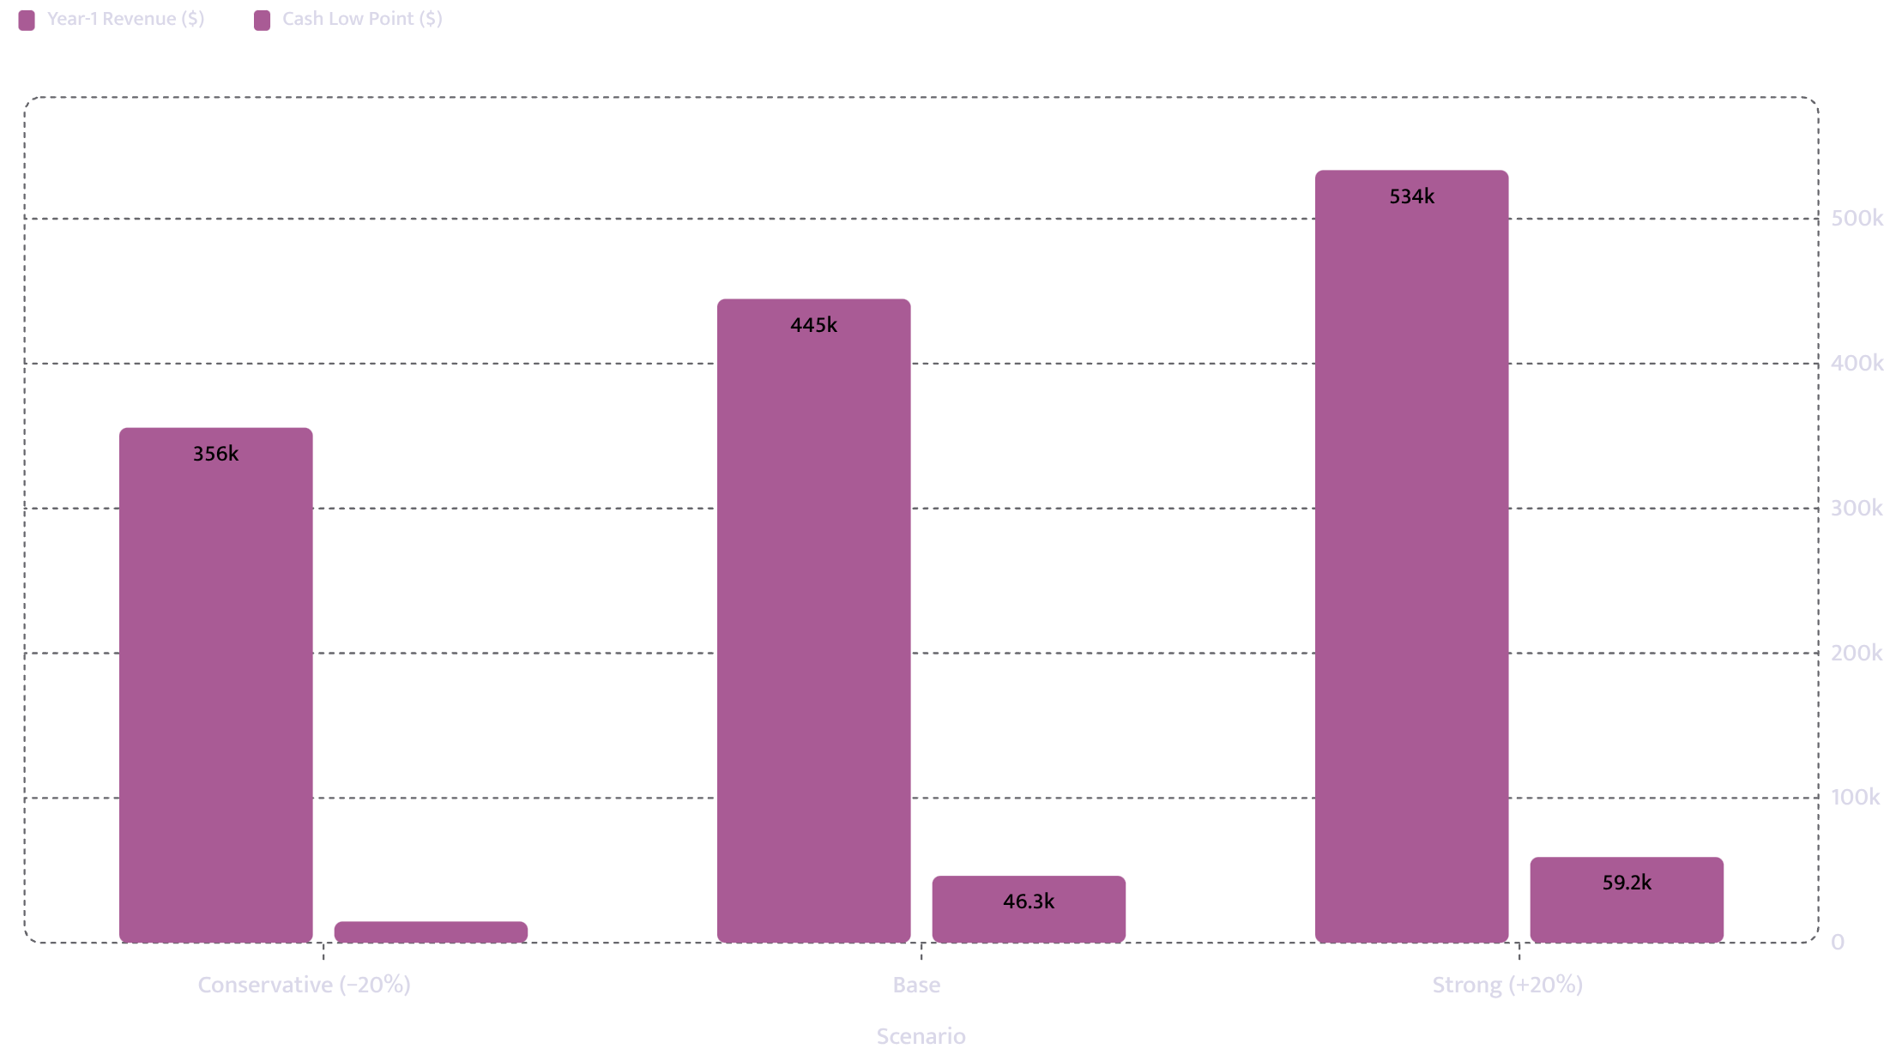
FINANCIALS → SCENARIO ANALYSIS
If Volume Comes In 20% Under
Scenario
Year-1 Revenue
Cash Low Point
Year-1 DSCR
Conservative (−20%)
$355,742
$14,685
-1.4
Base
$444,678
$46,260
1.92
Strong (+20%)
$533,606
$59,188
5.25
DSCR: Debt Service Coverage Ratio · Source: Harbor Lane Coffee LLC · Slide 22/31 · Confidential

Slide 23

FINANCIALS → INDUSTRY BENCHMARKS
How the Numbers Compare to the Industry
Ratio
This Plan
Industry Band
Status
Source
Cost of goods
26.3%
25–35%
Inside
National Restaurant Association, 2025, indicative
Rent
8.5%
8–14%
Inside
National Restaurant Association, 2025, indicative
Payroll
27.7%
28–38%
Outside
US Bureau of Labor Statistics, Current Employment Statistics, 2025, indicative
Payroll at 27.7% is below the 28–38% industry band. A ratio outside its band is not necessarily wrong — it is what an underwriter will ask about first.
Source: National Restaurant Association, Industry Operations Reporting, 2025; US Bureau of Labor Statistics, Current Employment Statistics, 2025 · Slide 23/31 · Confidential

Slide 24
SECTION III
03
Licensing, Team & Risks
Permit status, operator background, assumptions, and key risk factors
Source: Harbor Lane Coffee LLC · Slide 24/31 · Confidential

Slide 25
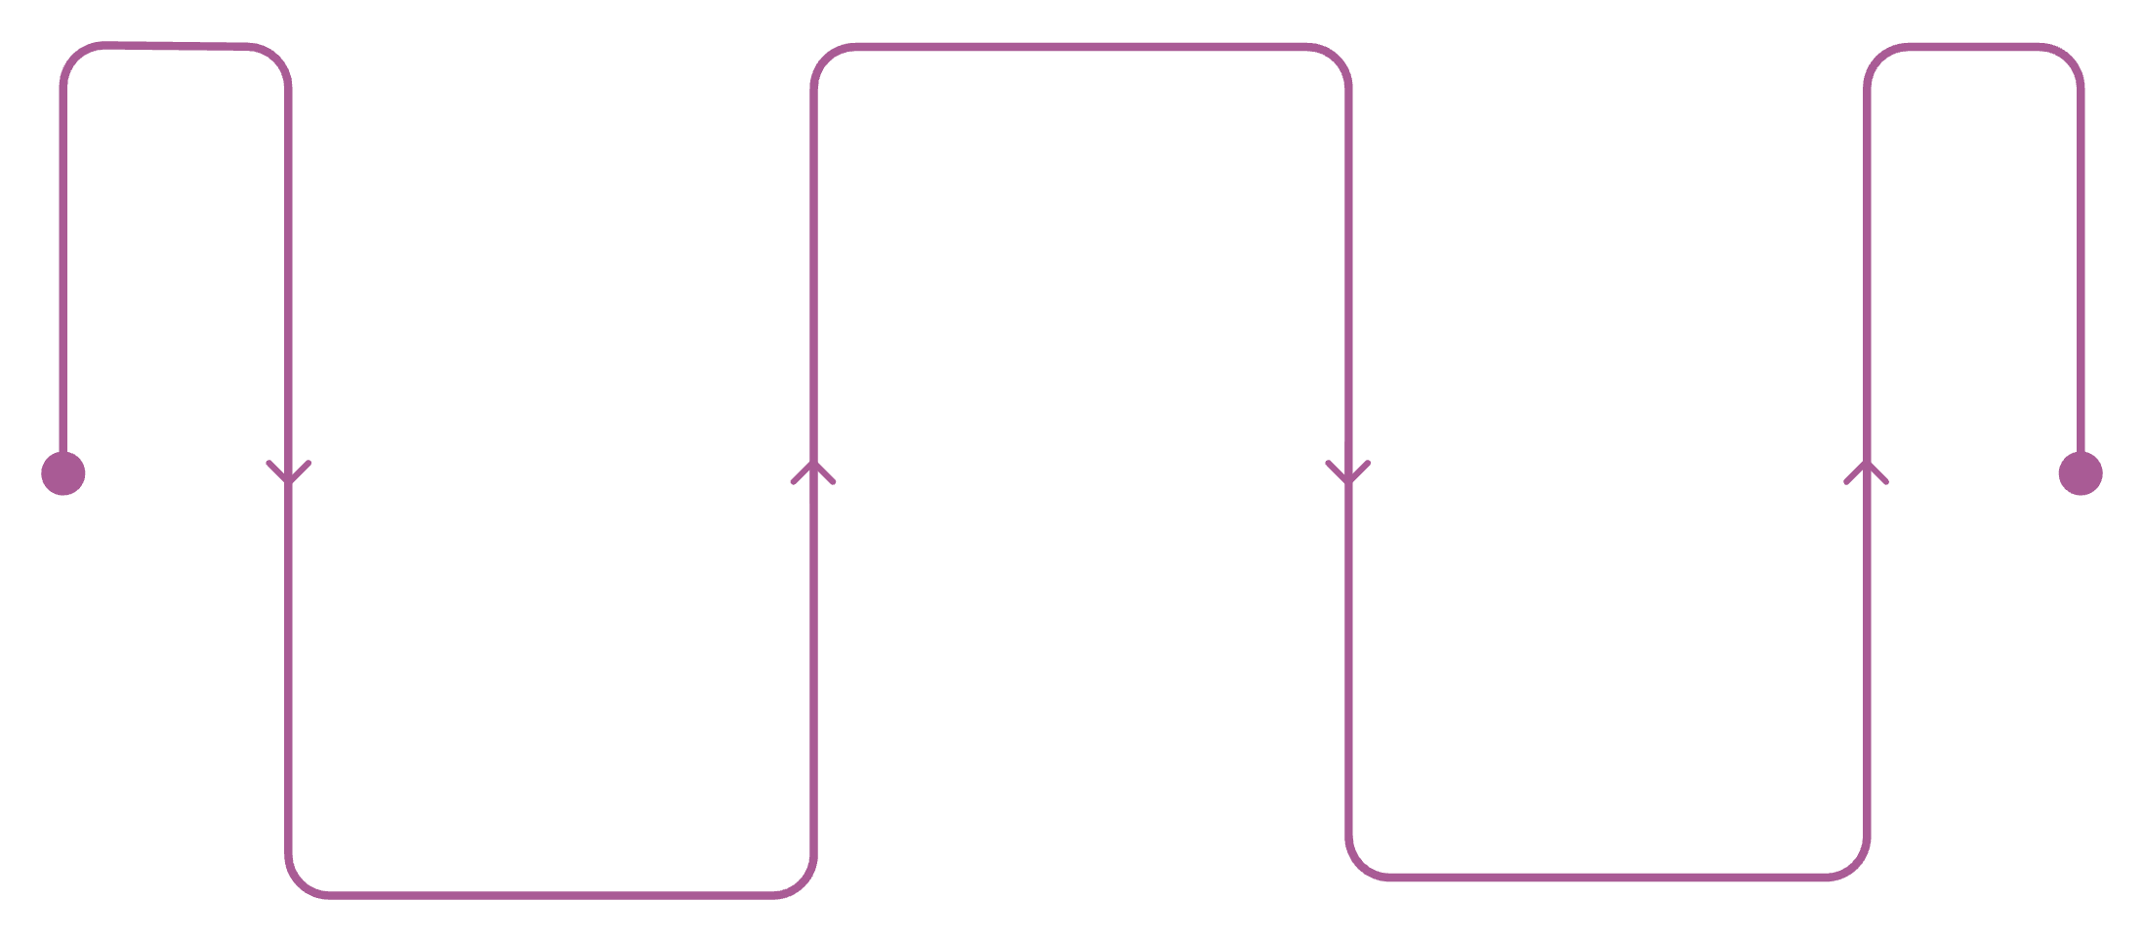
LICENSING & PERMITS
Licensing and Permits
Licence or Permit
Status
Cost
Lead Time
Business licence / trade name registration
Held
$150
2 weeks
Food service establishment permit
Applied
$400
6 weeks
Food handler / manager certification
Held
$160
1 week
Sales tax permit
Applied
$0
2 weeks
Certificate of occupancy
Not started
$350
8 weeks
Sign permit
Not started
$200
3 weeks
Applied
Food service permit, sales tax
Held
Not started
Business licence, food handler
Certificate of occupancy, sign permit
Source: Harbor Lane Coffee LLC · Slide 25/31 · Confidential

Slide 26
TEAM → OPERATOR BACKGROUND
Who Is Running It
9
1
Barista → Lead Barista
2
Café Manager
Four years at a two-site independent in Seattle with full P&L responsibility
Years in the speciality coffee trade
Ristretto Roasters — specialty coffee, front-line operations
Dana Whitfield — Managing Operator · 70% owner
3
Gap acknowledged
Bookkeeping at this scale — contracted to a local CPA at $280/month from month one, with a monthly close
P&L: Profit & Loss · CPA: Certified Public Accountant · Source: Harbor Lane Coffee LLC · Slide 26/31 · Confidential

Slide 27
TEAM → OWNERSHIP STRUCTURE
The Team
Known gap and mitigation
Dana Whitfield · 70%
Marcus Oyelaran · 30%
Neither principal has managed bookkeeping at this operating scale. The business has contracted a local CPA at $280 per month from month one, with a monthly close cycle rather than an annual review.
CPA: Certified Public Accountant · P&L: Profit & Loss
Managing operator — full-time day-to-day. Nine years specialty coffee, lead barista and two-site café manager with full P&L responsibility.
Co-owner. Both principals provide personal guarantees on the five-year lease.
Source: Harbor Lane Coffee LLC · Slide 27/31 · Confidential

Slide 28


RISKS → KEY DRIVERS
What Makes or Breaks a Coffee Shop
Day-part concentration
Average ticket is the lever
Most independents take 60–70% of daily revenue before 11am. Capacity at 8am — not average capacity — is the real ceiling.
Attaching food to a drink moves the ticket further than raising drink prices alone.
Espresso equipment risk
Input cost sensitivity
The single largest capex line and the one most often financed separately. Downtime is a direct revenue loss.
Milk and bean costs move; a plan with no sensitivity analysis on them is not credible. See assumptions table.
Capex: Capital Expenditure · Source: Harbor Lane Coffee LLC · Slide 28/31 · Confidential

Slide 29

RISKS → RAMP AND MITIGATION
Risks and Mitigations
Primary risk
Mitigations
The projections assume the business reaches 3,000 monthly transactions within the first seven months and stabilises near 6,200 thereafter. A slower ramp would extend the cash-trough period beyond month five and reduce the Year-1 DSCR below 1.92.
The conservative scenario (−20% volume) produces a cash low point of $14,685 and a DSCR of −1.4.
Documented operator P&L experience
Four years managing two-site operations in Seattle
Staffing flexibility
Third morning barista added only once volume justifies it
Demand evidence
Eleven-week pop-up at same corner averaged 118 transactions/day without paid marketing
DSCR: Debt Service Coverage Ratio · P&L: Profit & Loss · Source: Harbor Lane Coffee LLC · Slide 29/31 · Confidential

Slide 30
ASSUMPTIONS
Assumptions
Every figure is either supplied by the operator, confirmed by a document, or a benchmark default with its source named. The last column shows the effect of each assumption being 20% worse.
Assumption
Value
Source
If 20% worse
Price per unit
$7.80
Operator
DSCR → −2.59; cash low $−4,718
Variable cost per unit
$2.05
Operator
DSCR → 0.74; cash low $37,848
Steady-state volume
6,200 units/month
Operator
DSCR → −0.82; cash low $26,214
Monthly payroll (excl. owner)
$13,387
Operator
DSCR → 0.29; cash low $31,507
Monthly rent
$4,100
Confirmed from lease
DSCR → 1.43; cash low $42,160
COGS as % of revenue
26.3%
NRA band 25–35%, 2025, indicative
Inside the band
Rent as % of revenue
8.5%
NRA band 8–14%, 2025, indicative
Inside the band
Payroll as % of revenue
27.7%
BLS band 28–38%, 2025, indicative
Outside the band — expect to be asked
DSCR: Debt Service Coverage Ratio · COGS: Cost of Goods Sold · NRA: National Restaurant Association · BLS: US Bureau of Labor Statistics · Source: Harbor Lane Coffee LLC · Slide 30/31 · Confidential

Slide 31
SUMMARY · FUNDING REQUEST
The Request, Restated
$118K
32.8%
Loan Requested
Owner Injection
120 months at 11.25%
$42,000 of $128,000 total project cost
4,487
1.92
Break-Even Volume
Year-1 DSCR
Units/month — 57.5% of capacity, reached month 6
Against a lender floor of 1.25
DSCR: Debt Service Coverage Ratio · All figures provided by operator or confirmed by document · Source: Harbor Lane Coffee LLC · Slide 31/31 · Confidential

