Slide 1

Ridgeline Freight
Business Plan and Funding Request — SBA 7(a) / Microloan
A dry-van carrier running regional lanes out of East Tennessee, expanding from one owner-driven truck to three under its own FMCSA authority. Prepared for bank underwriter under SBA SOP.

Slide 2
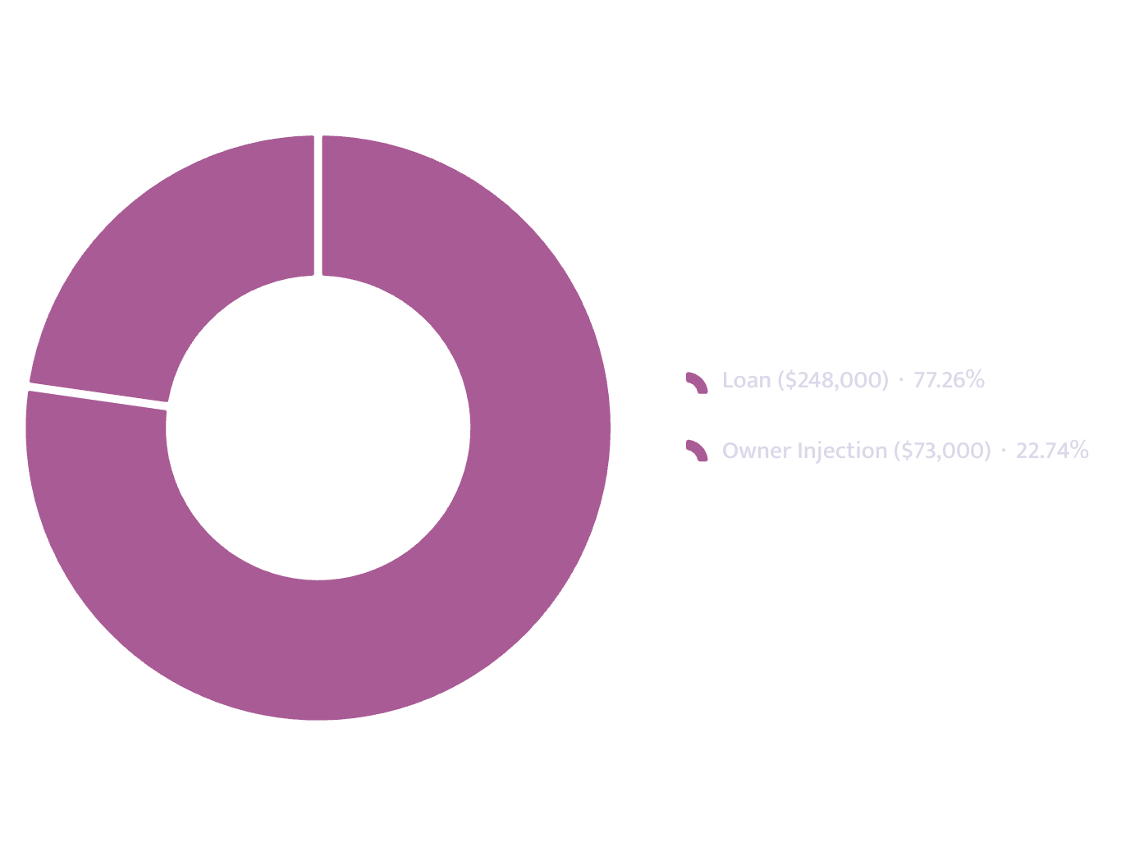
FUNDING REQUEST OVERVIEW
The Request
Loan requested
$248,000
Owner injection
$73,000 — 22.8% of project cost
Total startup requirement
$320,800
Term
84 months at 11.5%
Monthly debt service
$4,312
Year-1 DSCR
1.49 against a 1.25 floor
Total project cost: $320,800
DSCR: Debt Service Coverage Ratio

Slide 3
EXECUTIVE SUMMARY
The Plan in Six Numbers
$594K
18,781
Year-1 Revenue
Break-Even Units/Month
Mo. 5
59.6%
Break-Even Reached
Capacity at Break-Even
$9,062
$1.77
Cash Low Point (Month 4)
Contribution Per Unit

Slide 4
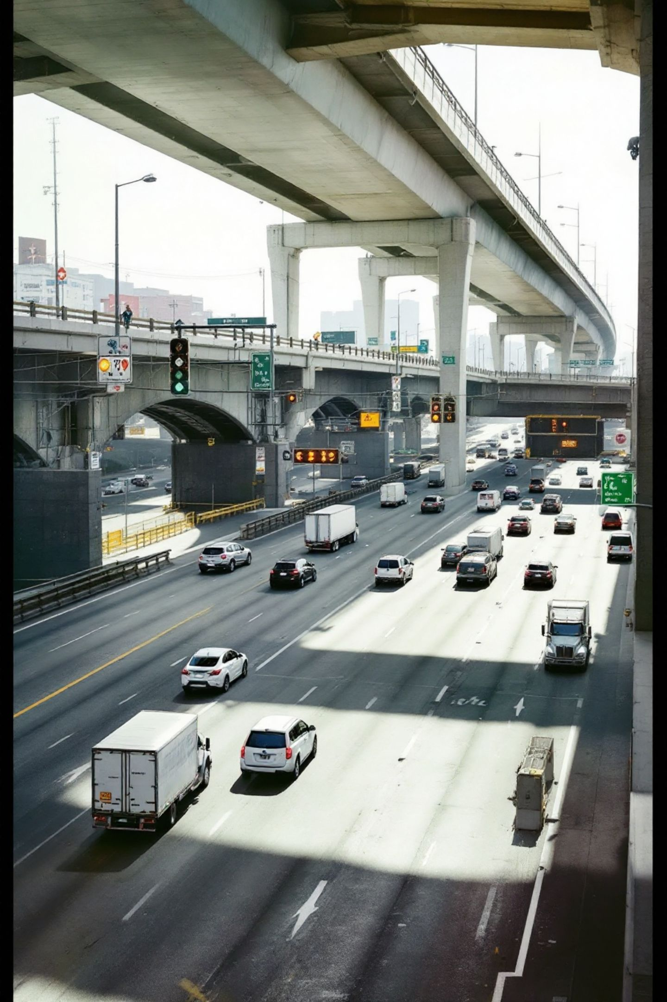
THE BUSINESS
Ridgeline Freight LLC
Formation & Authority
Geography & Revenue Mix
Tennessee LLC formed March 11, 2024. Wholly owned by Darnell Whitaker. Operates as a dry-van motor carrier under its own FMCSA authority out of Knoxville. Currently one owner-operated truck; plan adds two more.
500-mile radius on I-40 — Memphis to Atlanta, including Chattanooga distribution centers. Most drivers return home nightly. Revenue: 64% contracted lanes, 27% spot-market, 9% detention/accessorial.
118,400
$281,800
$2.38/mi
Loaded miles, trailing 12 months
Revenue, trailing 12 months
Average rate per loaded mile
94%
On-time delivery record

Slide 5

THE BUSINESS — CONTINUED
Operator Profile & Readiness
Darnell Whitaker — Class A CDL, 2012
Transition Planning
1
9 years
The company has identified the need for a part-time dispatcher and a trucking-specialist CPA to address the single-to-multi-truck transition.
Two shippers have indicated dedicated-lane offers conditional on the fleet reaching three trucks — enabling coverage during maintenance or breakdown.
Company driver, regional dry-van carrier
2
2 years
Leased to carrier
3
2 years
New authority carries elevated insurance costs for the initial two years — reflected in the operating plan.
Own FMCSA authority — no reportable accidents, clean CSA profile

Slide 6

MARKET
The Market
Operating Territory
500-mile radius from Knoxville along I-40. Covers Memphis–Atlanta freight corridors and Chattanooga distribution facilities. Lane structure supports nightly driver returns.
Demand Evidence
118,400 loaded miles and 94% on-time performance over the trailing twelve months. Two shippers have conditioned dedicated-lane commitments on the addition of a second and third truck.
Seasonality
Autumn peak; lowest month reaches 81% of average volume. No third-party demand forecasts are supplied — the two conditional lane offers and the twelve-month operating record are the sole demand evidence presented.

Slide 7
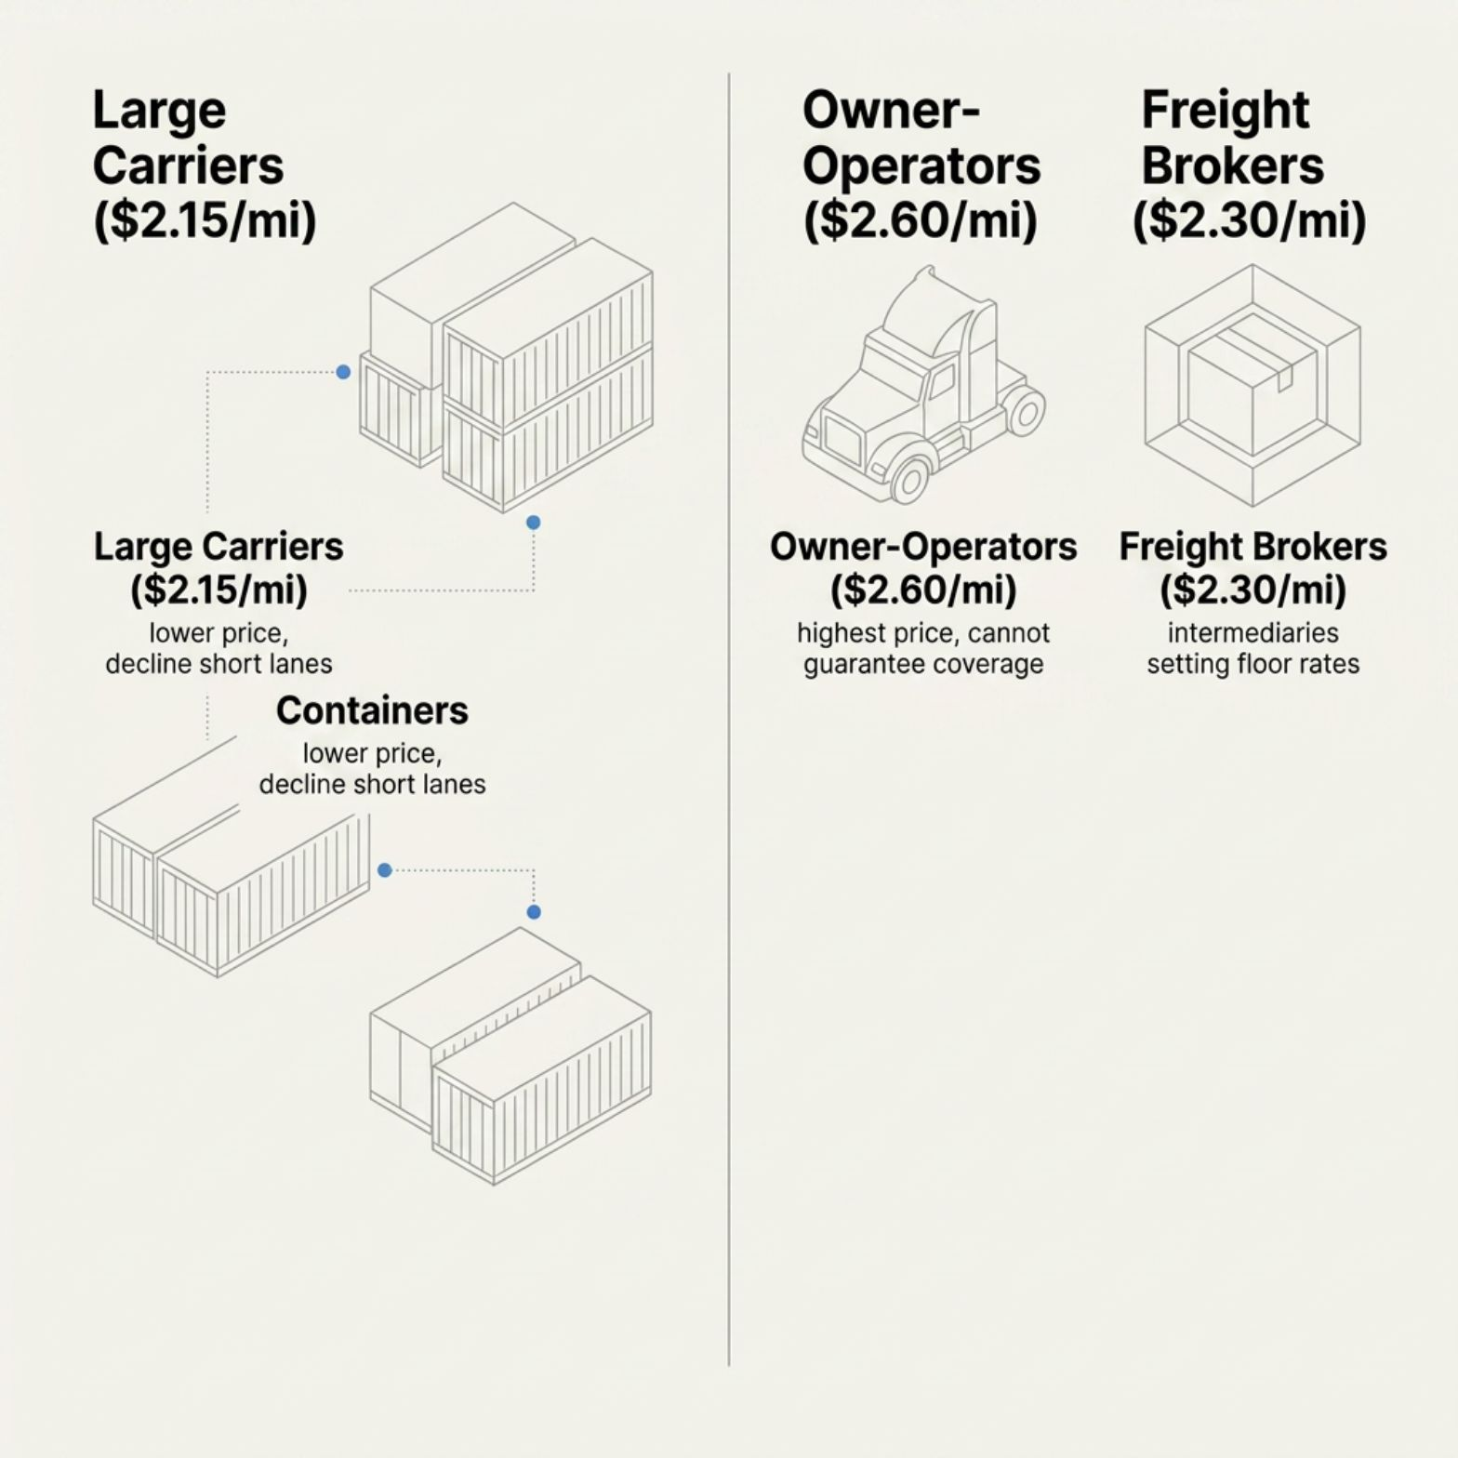
MARKET — CONTINUED
Market Dynamics & Positioning
Revenue Mix Shift
Current: 64% contracted regional lanes, 27% spot-market, 9% detention/accessorial. The plan targets increased contracted share by reducing spot reliance — improving rate stability without requiring additional loaded miles.
Competitive Landscape
Approximately 40 carriers compete within the 500-mile regional market. Three primary categories: large asset-based regional carriers, owner-operators on the spot market, and freight brokers.
Market-size estimates and precise competitor counts within the defined radius are not quantified in the available information.

Slide 8
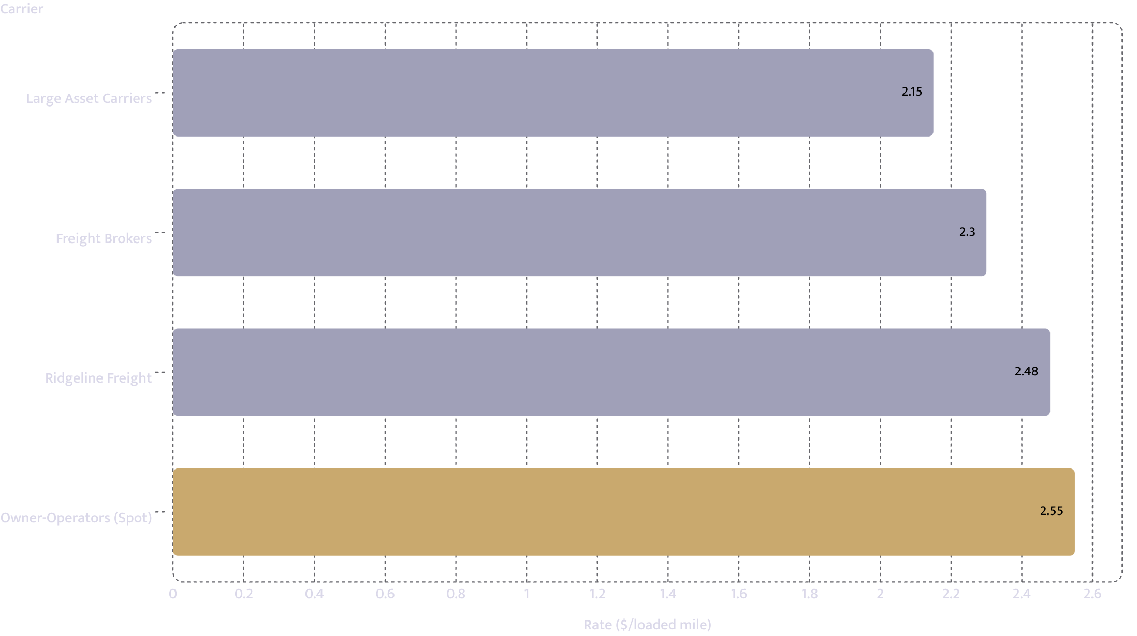
COMPETITION
Named Competitors and What They Charge
Competitor
$/Mile
Note
Large asset-based regional carriers
$2.15
Win major RFPs at scale; decline short-notice or shorter lanes
Owner-operators on the spot market
$2.55
Set the higher price point; cannot commit to a dedicated lane with one truck
Freight brokers (lowest available provider)
$2.30
Channel as much as competitor; set the spot floor Ridgeline aims to reduce reliance on
Ridgeline Freight
$2.48
Our position — reliability-differentiated

Slide 9

COMPETITION — CONTINUED
The Three-Truck Advantage
Three trucks is the point at which we can promise a shipper that a lane still runs when one truck is in the shop. That is the whole reason the two dedicated offers are conditional on the expansion.
Dedicated Lane Offers
Three-Truck Continuity
Ridgeline's current trailing twelve-month average: $2.38/mile, 94% on-time. Planned steady-state: $2.48/mile at 64% contracted lane share.
Single Truck Risk
Coverage continuity is the primary condition cited by both interested shippers and the structural gap neither owner-operators nor large carriers can fill on short regional lanes.

Slide 10


CUSTOMER ACQUISITION
How Customers Arrive
Sales Channel
64%
27%
Sales occur primarily through direct contracts rather than broker channels. The 500-mile radius keeps drivers on familiar lanes and enables most-night returns — supporting a 72% repeat-customer rate and 94% on-time performance.
Contracted regional lanes — primary revenue base
Spot-market loads — targeted for conversion to contracted lanes within six months
Demand Signal
Two shippers have conditioned dedicated-lane commitments on the addition of a second and third truck. No market-size estimates or third-party demand forecasts are supplied — the twelve-month operating record and two conditional lane offers are the sole demand evidence presented.
9%
81%
Detention and accessorial charges
Low-month seasonal floor relative to autumn peak

Slide 11
OPERATIONS
How It Runs
Fleet & Utilization
Staffing Plan
Trucks at steady state
3
Total headcount: 3.5 FTEs. All drivers under company authority — no independent contractors. FTE: Full-Time Equivalent.
Loaded miles per truck/month
10,500
Fleet total loaded miles/month
31,500
Utilization assumption
80%
Operating days/month
22
Hours/day
11 (hours-of-service limits)
01
02
03
Month 1
Month 3
Ongoing
Owner driving Truck 1; two hired company drivers for Trucks 2 and 3
Part-time dispatcher added at 20 hours/week
Trucking-specific CPA retained for bookkeeping at $340/month

Slide 12
OPERATIONS — CONTINUED
Steady-State Operations
$62,496
$28,930
$0.71
Steady-state monthly revenue at three trucks
Fixed monthly operating costs — includes elevated new-authority insurance
Variable cost per loaded mile
Equipment Standard
Coverage Advantage
Two used sleeper tractors (2021 and 2022), inspected. Two 53ft dry-van trailers. All units fitted with ELDs and dash cameras prior to service, maintained under scheduled budgets.
Three-truck fleet allows lane continuity when one unit is out for maintenance or inspection — the primary limitation of single-truck owner-operators and the condition cited by two interested shippers.
ELD: Electronic Logging Device

Slide 13
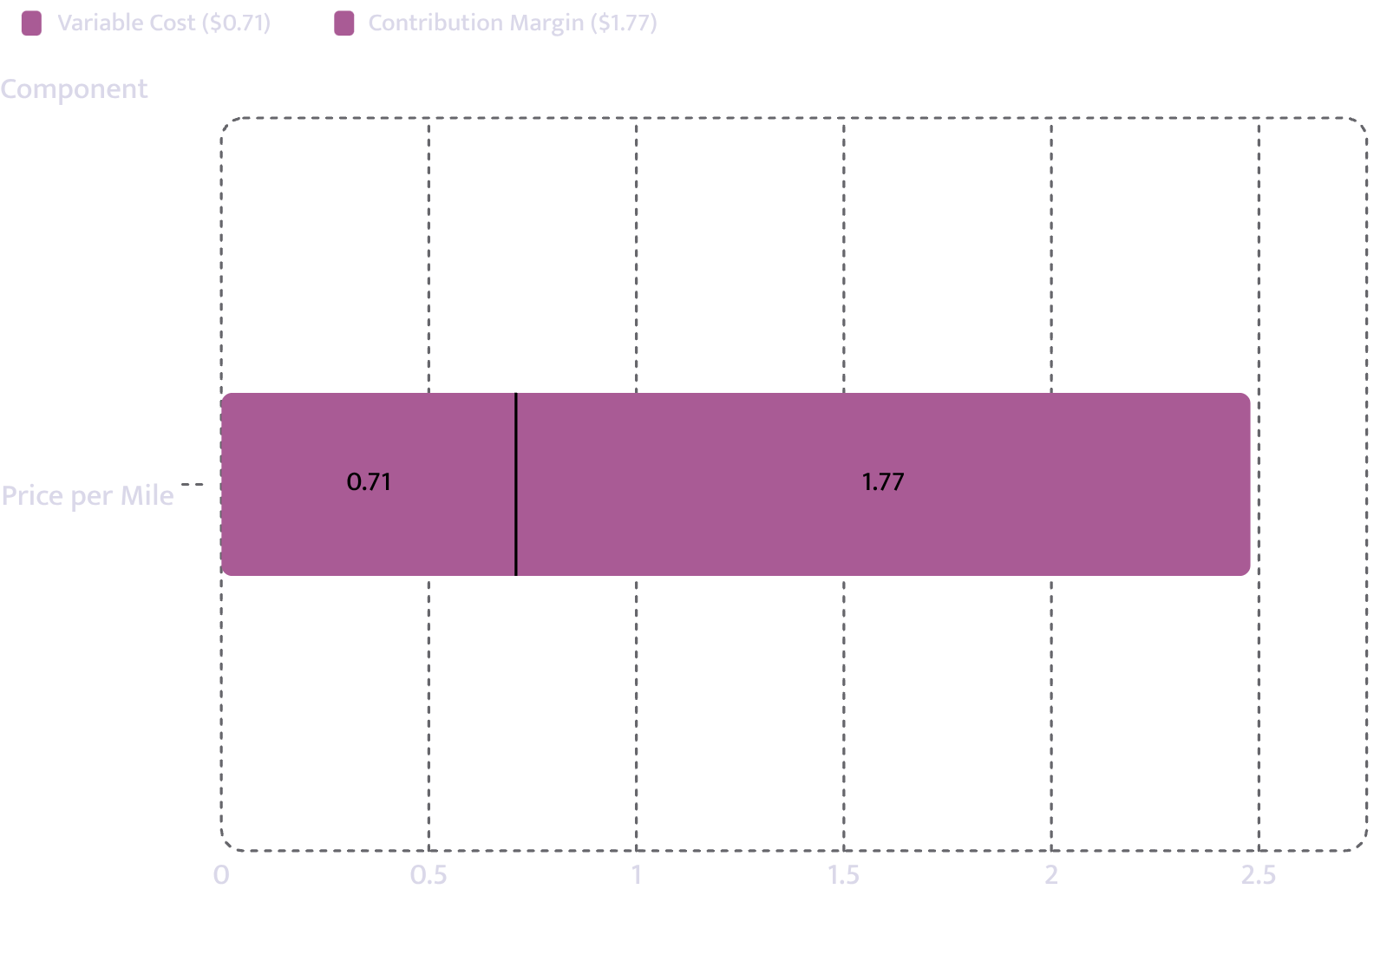

UNIT ECONOMICS
Unit Economics — One Loaded Mile
Price
$2.48
Variable cost
$0.71
Contribution margin
$1.77
COGS as % of revenue
28.6%
COGS: Cost of Goods Sold
Every dollar of revenue above $0.71 in variable cost contributes $1.77 toward fixed costs and debt service.

Slide 14
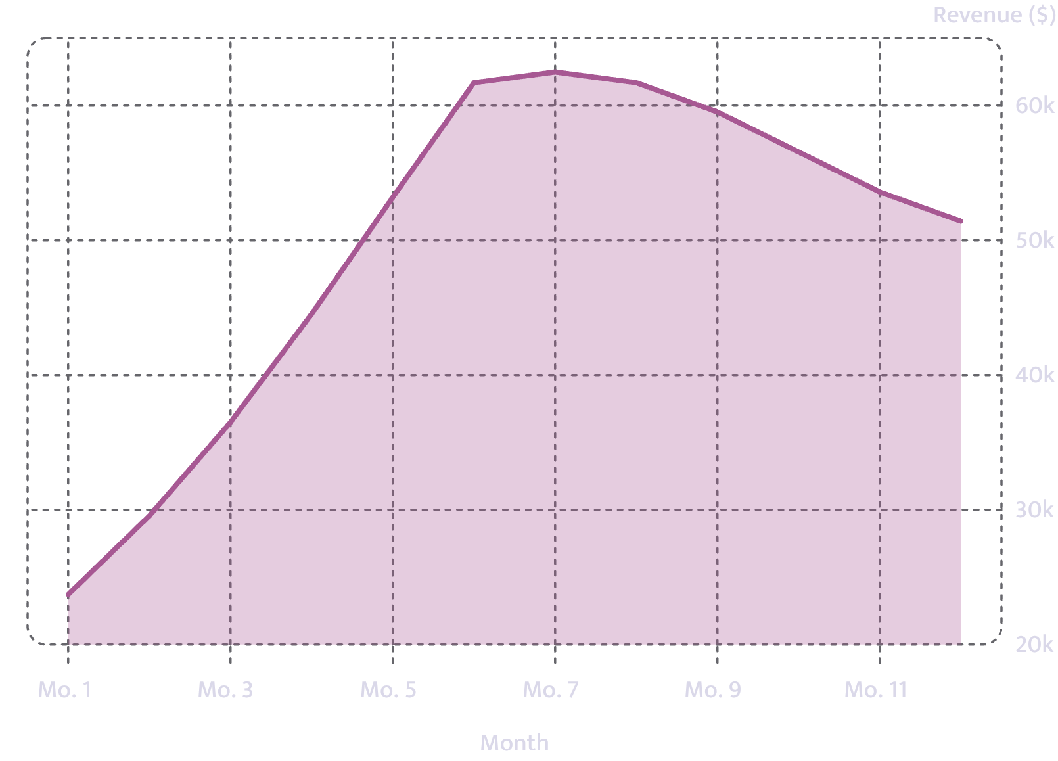
REVENUE MODEL
How Revenue Is Built
Opening month volume
11,800 units
Months to steady state
6
Steady-state volume
25,200 units/month
Steady-state revenue
$62,496/month
Year-1 revenue
$594,456

Slide 15
FINANCIAL PROJECTIONS
Year 1 — Months 1 to 6
Month
Units
Revenue
COGS
Gross
EBITDA
Net
1
9,558
$23,704
$6,786
$16,918
$(12,012)
$(16,324)
2
11,913
$29,544
$8,458
$21,086
$(7,844)
$(12,156)
3
14,715
$36,493
$10,448
$26,046
$(2,884)
$(7,196)
4
17,955
$44,528
$12,748
$31,780
$2,850
$(1,461)
5
21,450
$53,196
$15,230
$37,967
$9,037
$4,725
6
24,879
$61,700
$17,664
$44,036
$15,106
$10,794
EBITDA: Earnings Before Interest, Taxes, Depreciation & Amortisation | COGS: Cost of Goods Sold

Slide 16
FINANCIAL PROJECTIONS
Year 1 — Months 7 to 12
Month
Units
Revenue
COGS
Gross
EBITDA
Net
7
25,200
$62,496
$17,892
$44,604
$15,674
$11,362
8
24,879
$61,700
$17,664
$44,036
$15,106
$10,794
9
24,003
$59,527
$17,042
$42,485
$13,555
$9,243
10
22,806
$56,559
$16,192
$40,367
$11,437
$7,125
11
21,609
$53,590
$15,342
$38,248
$9,318
$5,006
12
20,733
$51,418
$14,720
$36,697
$7,767
$3,456
Year 1 Total
239,700
$594,456
$170,187
$424,269
$77,109
$25,367
EBITDA: Earnings Before Interest, Taxes, Depreciation & Amortisation | COGS: Cost of Goods Sold

Slide 17
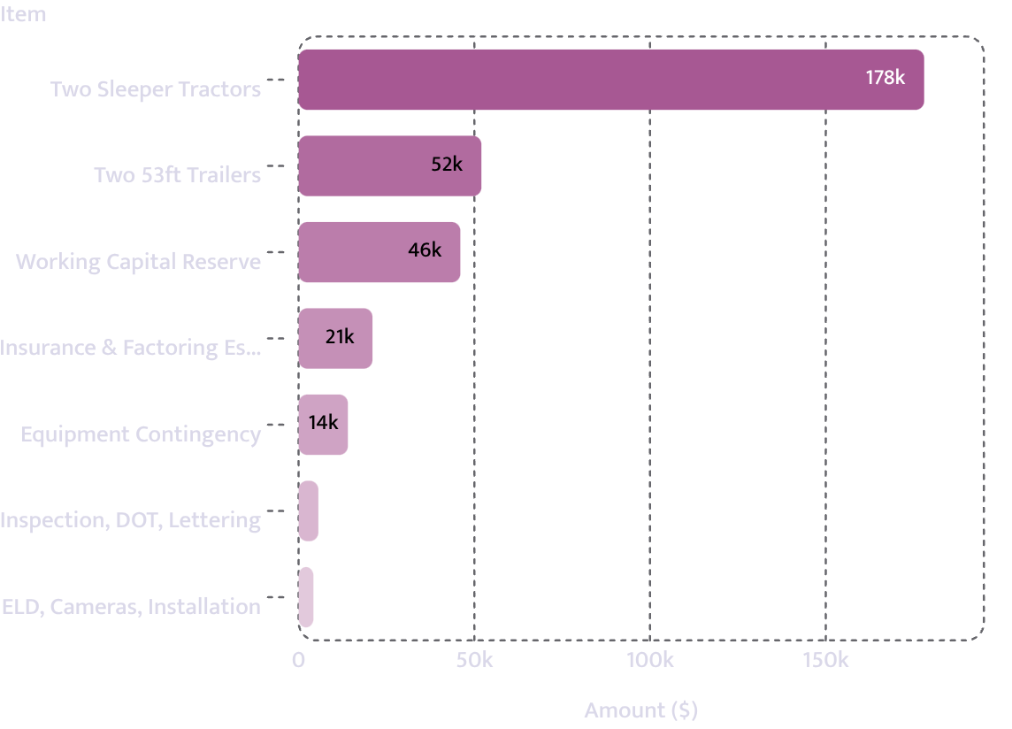
STARTUP COSTS
What It Costs to Open the Doors
Item
Amount
Basis
Two used sleeper tractors (2021 & 2022), inspected
$178,000
Quote
Two dry-van trailers, 53ft
$52,000
Quote
ELD hardware, dash cameras and installation
$4,200
Quote
Factoring escrow and first-year insurance down payment
$21,000
Quote
Pre-service inspection, DOT compliance and lettering
$5,600
Estimate
Contingency on used-equipment repair at first service
$14,000
Estimate
ELD: Electronic Logging Device | DOT: Department of Transportation
Capital expenditure
$274,800
Working-capital reserve
$46,000
Operator
Total requirement
$320,800

Slide 18
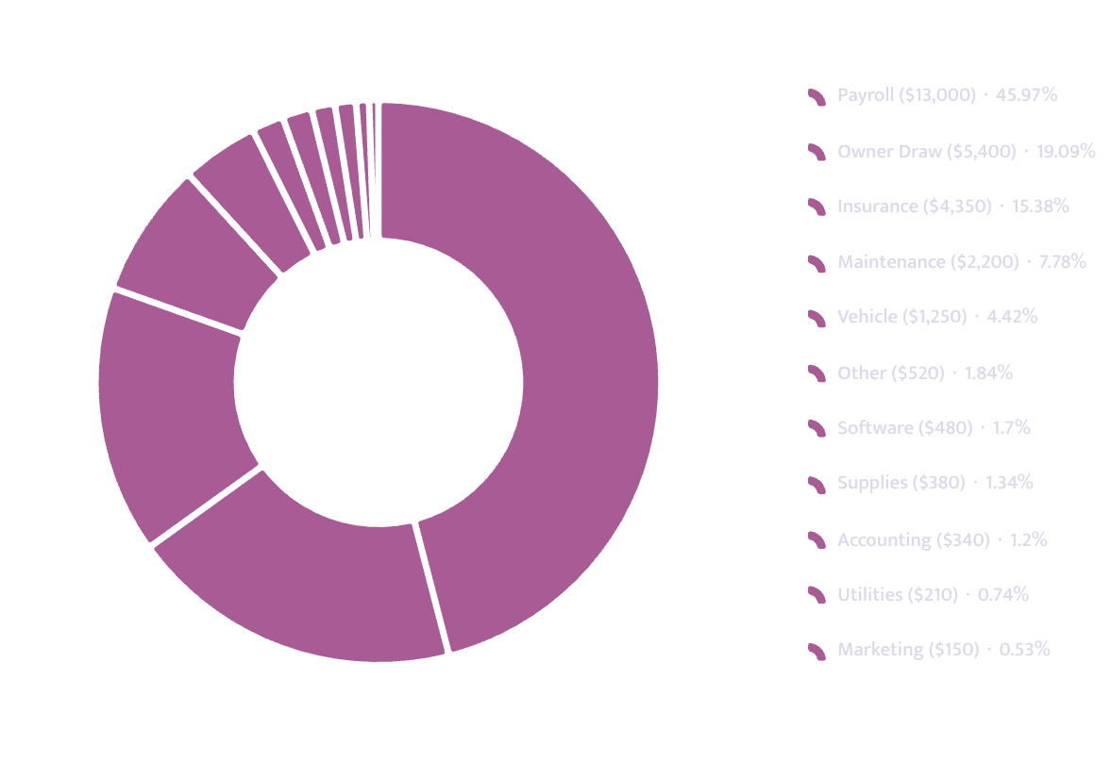
OPERATING COSTS
What It Costs to Stay Open
Fixed Monthly Cost
Amount
Payroll
$13,000
Owner draw
$5,400
Insurance
$4,350
Maintenance
$2,200
Vehicle
$1,250
Software
$480
Accounting
$340
Supplies
$380
Other
$520
Utilities
$210
Rent
$650
Marketing
$150
Total fixed monthly
$28,930

Slide 19
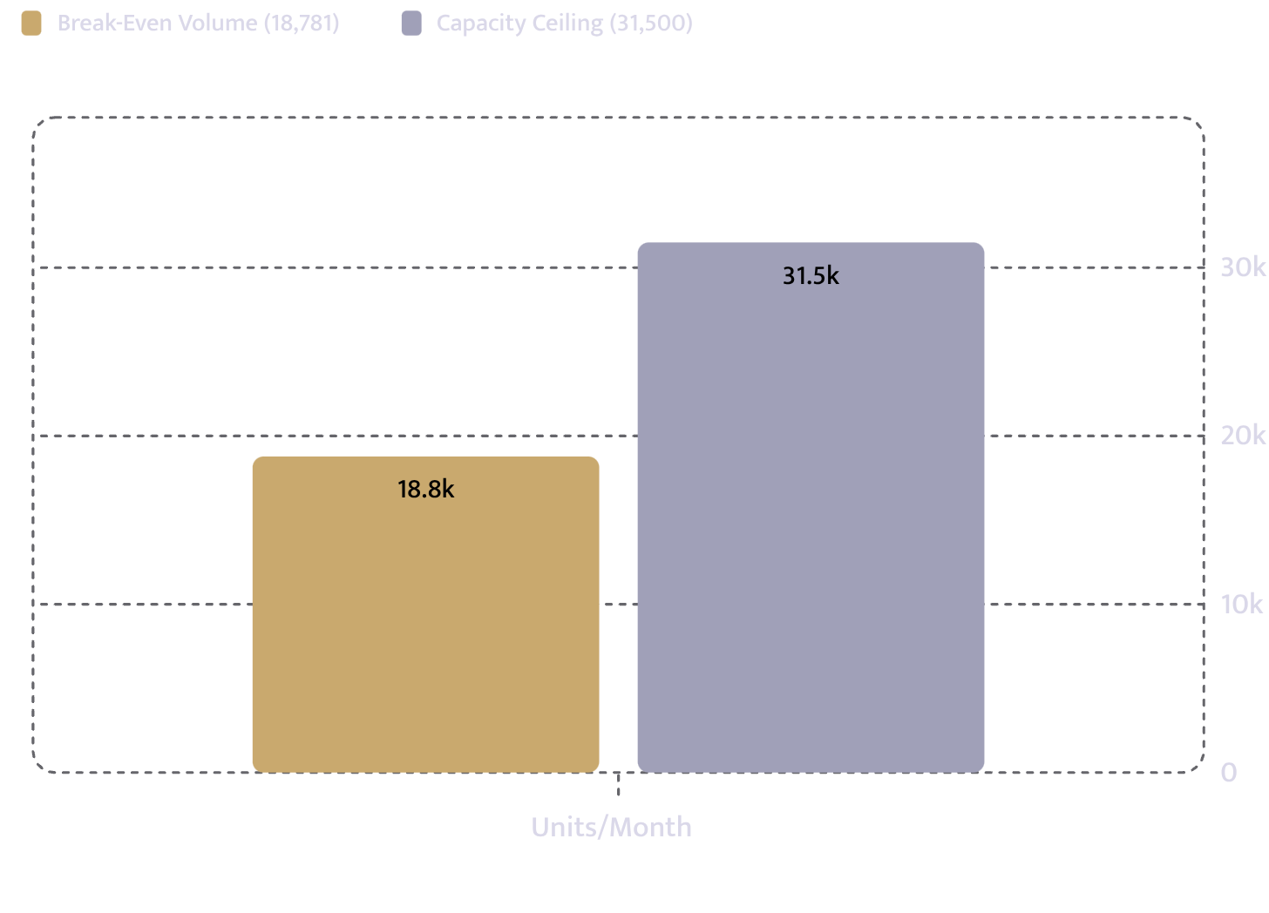
BREAK-EVEN ANALYSIS
Break-Even
Fixed costs plus debt service
$33,242/month
Contribution per unit
$1.77
Break-even volume
18,781 units/month
Break-even revenue
$46,577
Capacity ceiling
31,500 units/month
Headroom
59.6% of capacity required
Break-even is reached in month 5. The operation needs to deploy only 59.6% of its fleet capacity to cover all fixed obligations.
40.4% capacity headroom above break-even threshold

Slide 20
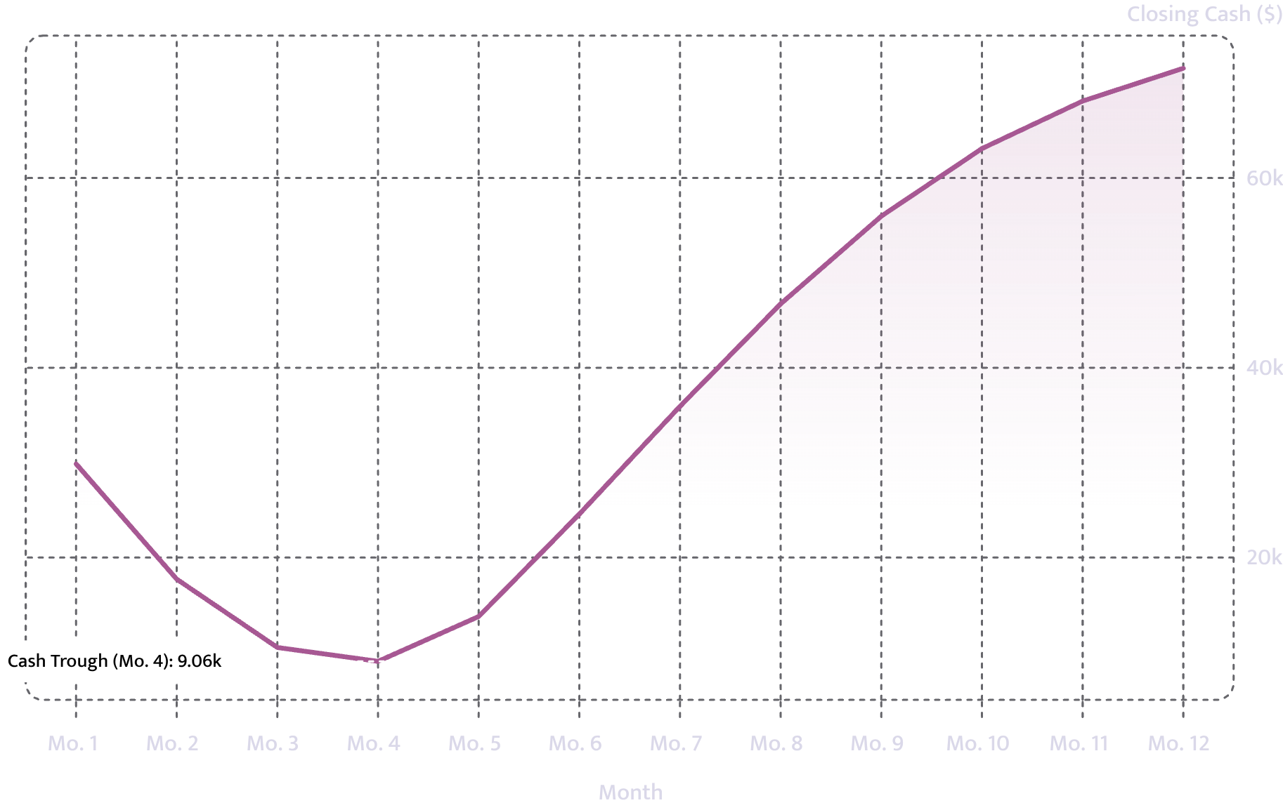

CASH POSITION
Cash Across Year 1
Opening cash after startup spend: $46,200
Low point: $9,062 in month 4 — before break-even is achieved in month 5.
Cash recovers steadily from month 5, closing year 1 at $71,567.
Month 4 trough of $9,062 is the critical liquidity watch point. The working-capital reserve is the primary buffer.

Slide 21
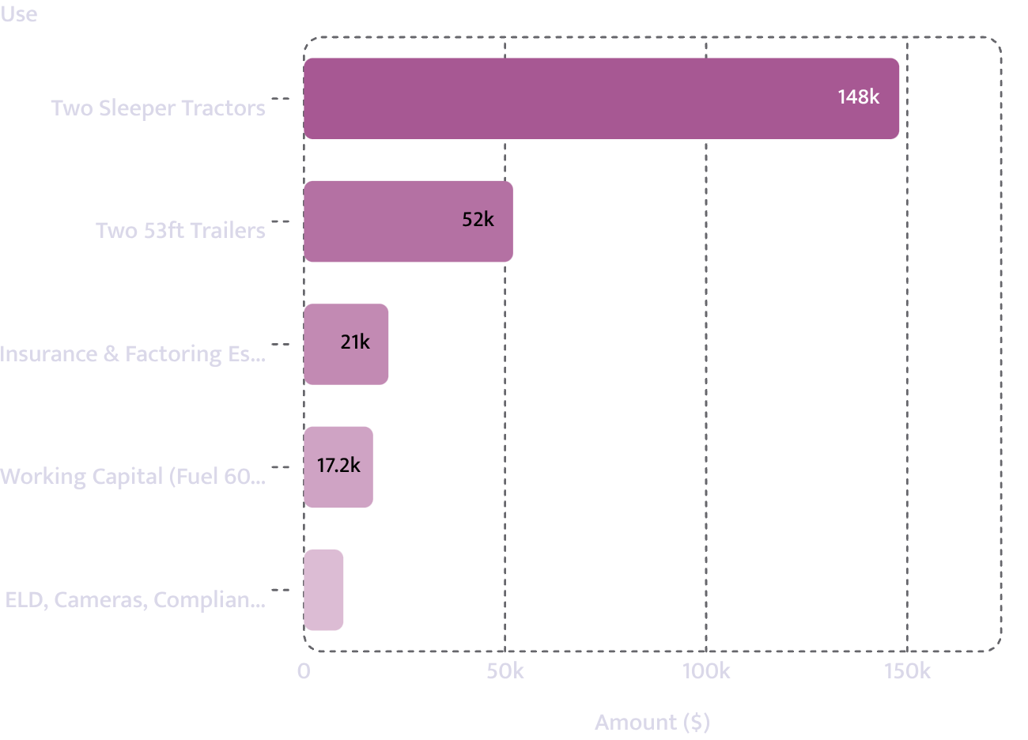
USE OF FUNDS
Use of Loan Proceeds
Use
Amount
Two used sleeper tractors
$148,000
Two 53ft dry-van trailers
$52,000
Insurance down payment and factoring escrow
$21,000
ELD, cameras, compliance and lettering
$9,800
Working capital — first 60 days of fuel
$17,200
Total
$248,000
Uses total exactly the amount requested. ELD: Electronic Logging Device

Slide 22
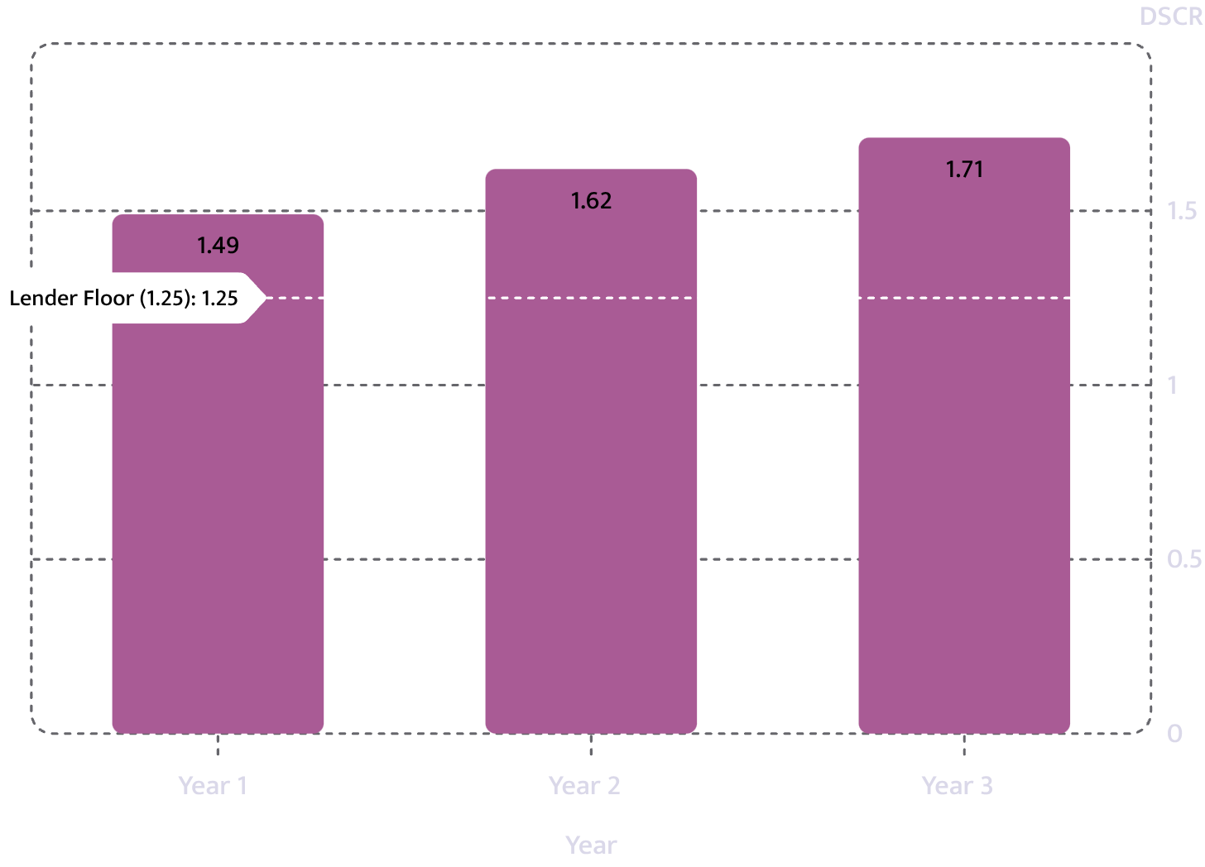
DEBT SERVICE
Debt Service Coverage
Year 1
Year 2
Year 3
DSCR
1.49
1.62
1.71
Lender floor
1.25
1.25
1.25
DSCR: Debt Service Coverage Ratio — net operating income divided by total debt service. A ratio above 1.0 means the business generates more than enough cash to service its debt.
Year-1 DSCR of 1.49 exceeds the lender's 1.25 floor by a margin of 0.24. Coverage improves through Year 3 as contracted lane share increases.

Slide 23
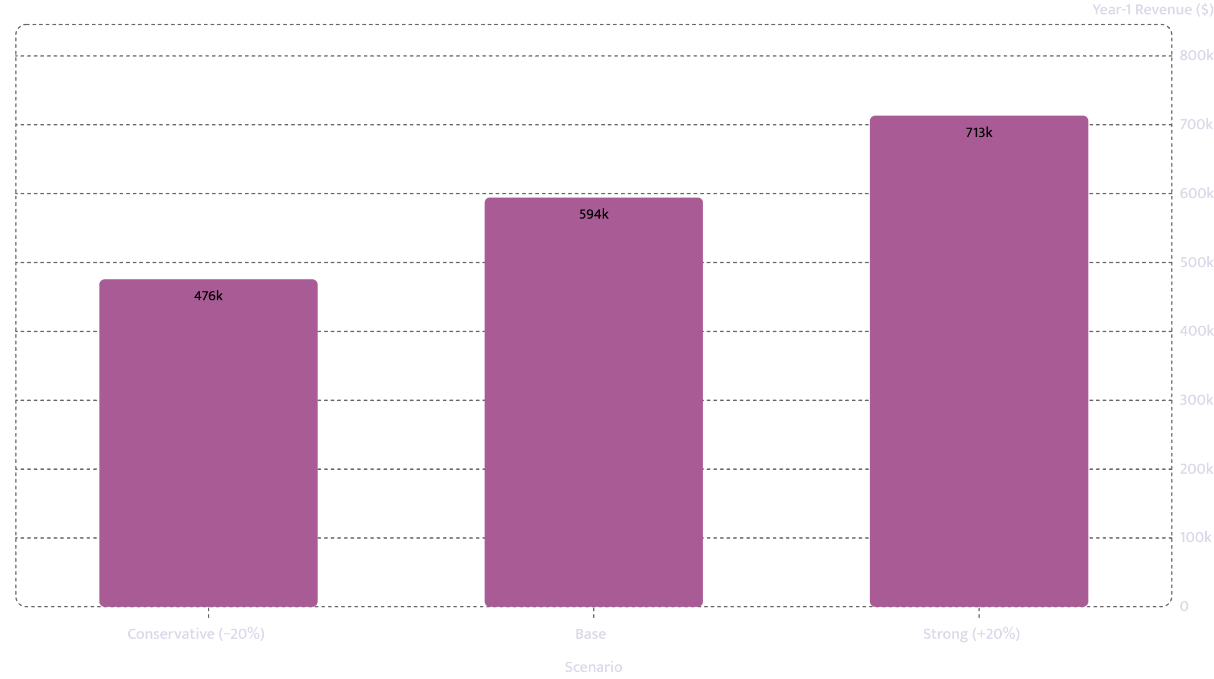
SCENARIO ANALYSIS
If Volume Comes In 20% Under
Scenario
Year-1 Revenue
Cash Low Point
Year-1 DSCR
Conservative (−20%)
$475,560
$(13,290)
-0.15
Base
$594,456
$9,062
1.49
Strong (+20%)
$713,350
$23,335
3.13
DSCR: Debt Service Coverage Ratio. A negative DSCR in the conservative scenario indicates insufficient cash flow to cover debt service — the working-capital reserve and owner injection are the buffers.

Slide 24
INDUSTRY BENCHMARKS
How the Numbers Compare to the Industry
Ratio
This Plan
Industry Band
Status
Source
Cost of goods (COGS)
28.6%
30–45%
Outside
American Trucking Associations, operational cost reporting, 2025
Rent
1.0%
4–15%
Outside
US Census Bureau, County Business Patterns, 2024, indicative
Payroll
20.8%
25–40%
Outside
American Trucking Associations, operational cost reporting, 2025, indicative
Every ratio falls outside its cited industry band. A ratio outside its band is not necessarily wrong — it is what an underwriter will ask about first. COGS: Cost of Goods Sold

Slide 25

LICENSING & PERMITS
Licensing and Permits
Licence or Permit
Status
Cost
Lead Time
FMCSA operating authority (MC number)
Held
$300
8 weeks
USDOT number
Held
$0
2 weeks
Liability insurance $750k–$1M
—
$12,000
3 weeks
IFTA registration
Held
$100
3 weeks
BOC-3 process agent filing
Held
$50
1 week
FMCSA MC
IFTA
Liability
Held — 8 weeks
USDOT
Held — 3 weeks
BOC-3
$750k–$1M — Not started
Held — 2 weeks
Held — 1 week
FMCSA: Federal Motor Carrier Safety Administration | IFTA: International Fuel Tax Agreement | BOC-3: Blanket of Coverage-3 | USDOT: United States Department of Transportation

Slide 26

KEY RISK FACTORS
What Makes or Breaks a Trucking Business
Cost Per Mile
Cost per mile — not revenue per mile — decides viability. The plan must demonstrate that variable and fixed costs are controlled at scale.
Insurance Premium
New authorities pay a heavy insurance premium for the first two years. At $4,350/month, this is the single largest non-payroll fixed cost and must be shown in full.

Slide 27


MANAGEMENT
Who Is Running It
14 Years in the Trade.
Nine years as a company driver for a regional dry-van carrier. Two years leased to a carrier. Two years running under own FMCSA authority — clean CSA record and no reportable accidents.
The gap we know about. Never managed drivers who are not me. Budgeted a dispatcher at 20 hours a week from month three rather than pretending I can dispatch two other trucks from a cab. Bookkeeping moved to a trucking-specific CPA at $340/month. CSA: Compliance, Safety, Accountability

Slide 28
MANAGEMENT & TEAM
The Team
Darnell Whitaker — Principal
Planned Team Structure
100% ownership. Tennessee LLC formed March 11, 2024. Holds Class A CDL issued 2012. Clean motor vehicle record, clean CSA record, current medical certificate. Has managed P&L for the existing single-truck operation.
Total: 3.5 FTEs. No other equity holders. Ownership and control unchanged. CPA: Certified Public Accountant | P&L: Profit and Loss | FTE: Full-Time Equivalent
Commercial Experience
9 years — company driver, regional dry-van carrier
2 years — leased to carrier
2 years — own FMCSA authority
01
02
Owner (Whitaker)
Two Company Drivers
Full-time; drives Truck 1, oversees operations
Hired for Trucks 2 and 3; all under company authority — no independent contractors
03
04
Part-Time Dispatcher
Trucking-Specialist CPA
Added month 3; 20 hours/week
Bookkeeping; $340/month fixed

Slide 29

RISK ANALYSIS
Risks and Mitigations
New Authority Insurance Premium
Driver Management Inexperience
Used Equipment Repair Exposure
Risk: Materially higher premiums during first two years. $4,350/month insurance line item must be absorbed while converting spot miles to contracted lanes.
Mitigation: Reflected in full in operating plan. Budget built around this elevated cost.
Risk: Operator has not previously supervised non-owner drivers.
Mitigation: Part-time dispatcher budgeted from month three. Bookkeeping outsourced to trucking-specific CPA, limiting simultaneous duties as driver and supervisor.
Risk: Used tractors (2021 and 2022) carry repair and downtime risk at first service.
Mitigation: $14,000 contingency line and pre-purchase inspections on both units before service entry.

Slide 30

RISK ANALYSIS — CONTINUED
Risks and Mitigations (Continued)
Collateral and Lender Protection
Seasonality & Spot Exposure
Break-Even Margin
Fixed monthly costs of $28,930 produce a break-even revenue requirement of $46,577 — reached in month five under stated utilization and rate assumptions. Year-1 DSCR of 1.49 provides a positive margin above the $4,312 monthly obligation.
Collateral pledged
Two new tractors, two trailers, existing 2020 tractor
Low-month revenue floor: 81% of peak. 27% of planned revenue remains spot-market exposure. Countered by 64% contracted share and two dedicated-lane offers available at three trucks.
Owner cash injection
$73,000 — 22.76% of total startup requirement
These elements limit lender exposure while the operation stabilizes. No representation is made regarding the likelihood of loan approval or repayment outcomes.
DSCR: Debt Service Coverage Ratio

Slide 31
ASSUMPTIONS
Assumptions — Primary Inputs
Assumption
Value
Source
If 20% Worse
Price per unit (loaded mile)
$2.48
Operator-provided
DSCR 1.49 → -0.81; cash low point $-47,324
Variable cost per unit
$0.71
Operator-provided
DSCR 1.49 → 0.83; cash low point $1,374
Steady-state units/month
25,200
Operator-provided
DSCR 1.49 → 0.05; cash low point $-2,699
Monthly payroll (excl. owner)
$13,000
Operator-provided
DSCR 1.49 → 0.89; cash low point $-1,338
Monthly rent
$0
Operator-provided
DSCR 1.49 → 1.49; cash low point $9,062
COGS as % of revenue
28.6%
Industry band 30–45% — American Trucking Associations, 2025
Outside the band; expect to be asked about it
DSCR: Debt Service Coverage Ratio | COGS: Cost of Goods Sold

Slide 32
ASSUMPTIONS — CONTINUED
Assumptions — Industry Band Comparisons
Assumption
Value
Source
If 20% Worse
Rent as % of revenue
1.0%
Industry band 4–15% — US Census Bureau, County Business Patterns, 2024, indicative
Outside the band; expect to be asked about it
Payroll as % of revenue
20.8%
Industry band 25–40% — American Trucking Associations, 2025, indicative
Outside the band; expect to be asked about it
All three ratios — COGS, rent, and payroll as a percentage of revenue — fall outside their cited industry bands. These are the figures an underwriter will scrutinize first. Each is operator-supplied or sourced from published benchmarks and is reproduced here without adjustment.
Every figure in this deck is final as provided. No figures have been rounded, re-scaled, or recalculated. COGS: Cost of Goods Sold

Slide 33
SUMMARY
The Request, Restated
$248,000
$73,000
Loan requested over 84 months at 11.5%
Owner injection — 22.8% of total project cost
18,781 units
1.49 DSCR
Break-even volume per month — 59.6% of capacity — reached month 5
Year-1 debt service coverage against a 1.25 lender floor
Ridgeline Freight LLC presents a regional dry-van carrier with a fourteen-year operating track record, two conditional dedicated-lane commitments, and a three-truck expansion plan supported by documented startup costs, a month-level cash model, and a year-1 DSCR of 1.49.
The working-capital reserve of $46,000 and owner injection of $73,000 provide the primary buffers through the month-4 cash trough of $9,062. No representation is made regarding the probability or likelihood of loan approval.
DSCR: Debt Service Coverage Ratio

